Slide 1

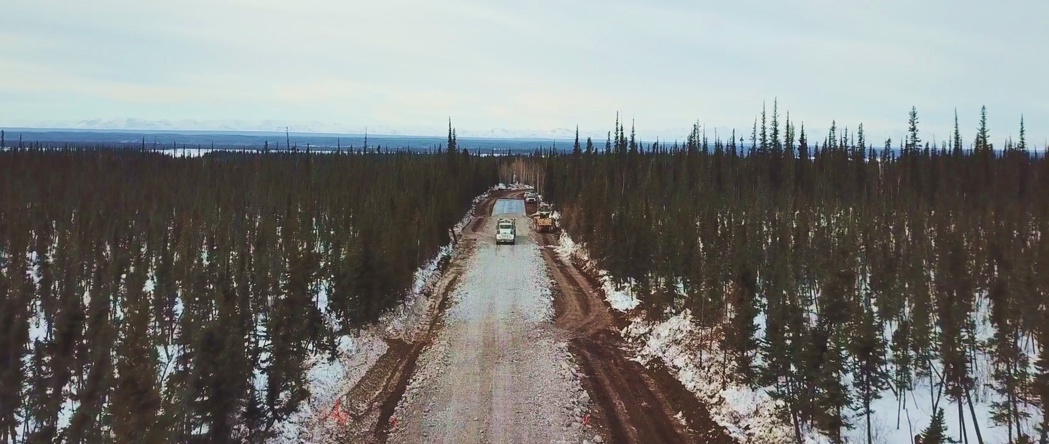

CONNECTING TO OPPORTUNITIES
Mackenzie Valley Highway
Wrigley Community Meeting
Department of Infrastructure
July 2019

Slide 2

CONNECTING TO OPPORTUNITIES
Purpose
To provide an update on Mackenzie Valley Highway (MVH) activities in the Dehcho Region:
MVH Environmental Assessment (Wrigley to Norman Wells)
Wrigley to Mount Gaudet all-weather Access Road (MGAR)

Slide 3
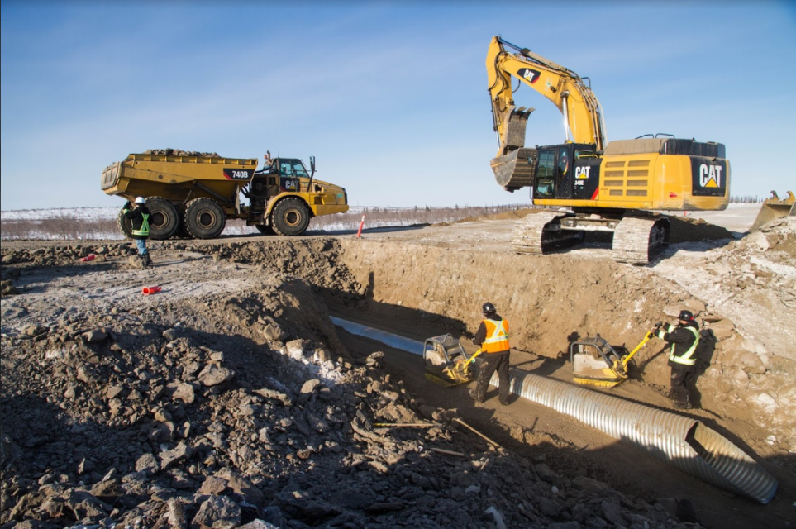
CONNECTING TO OPPORTUNITIES
Why Invest in Infrastructure?
Improve social opportunities
Reduce cost of living and doing business
Increase resiliency to impacts of climate change
Support development of strong northern workforce and business opportunities
Promote tourism opportunities
Reduce greenhouse gas emissions
Provide access to mineral and petroleum resources
Green the mining sector
Indigenous economic reconciliation
3

Slide 4

CONNECTING TO OPPORTUNITIES
MVH Environmental Assessment
Developer’s Assessment Report
  Completion of the DAR is the next major step
  Scope and timing of studies required to complete the DAR to be determined
  Preliminary target date for completing DAR is late 2021

Slide 5
CONNECTING TO OPPORTUNITIES
MVH EA – Anticipated Timeline
July 2019

Slide 6
CONNECTING TO OPPORTUNITIES
Mount Gaudet Access Road (MGAR)
Construction of the MGAR may proceed in advance of the MVH EA
Development of the MGAR will include:
  Expansion of quarry at Mount Gaudet
  Relocation of Hodgson Creek Bridge

Slide 7
CONNECTING TO OPPORTUNITIES
MGAR - Anticipated Timeline
July 2019

Slide 8
CONNECTING TO OPPORTUNITIES
Planned Studies – MVH EA and MGAR
Studies to be completed will include:
The GNWT is also in the process of acquiring land access and permits for the MGAR and associated projects.
  Environmental
    Wildlife Desktop Studies
    Wildlife Field Studies
  Archaeological
    Overview Assessment
    Impact Assessment (if required)
  Land use
  Socio-economic
  Traditional knowledge
  Engineering
    Geotechnical
    Route design
    Hydrology
    Thermal analysis
LiDAR (Hodgson Creek)
Terrain and air photo analysis
Topography

Slide 9


CONNECTING TO OPPORTUNITIES
Memorandum of Understanding
Proposed MOU between GNWT and Pehdzéh Kı̨́ First Nation (PKFN)
Cooperation on the Advancement of the MVH through the Environmental Review and Regulatory Processes

Slide 10
CONNECTING TO OPPORTUNITIES
MOU - Introduction and Purpose
MOU will formalize the working relationship between GNWT and PKFN
Funding now available for planning and environmental studies for the MVH, construction of the Great Bear River Bridge, and construction of MGAR
Long-term goal to connect the communities along the Mackenzie River by all-weather road to the national highway system
A portion of the MVH is within the traditional territory of PKFN
GNWT and PKFN support the ongoing development of the MVH into an
all-weather highway
GNWT and PKFN commit to working together in partnership to advance the development of the MVH

Slide 11

CONNECTING TO OPPORTUNITIES
MOU - Scope
The GNWT and PKFN will work together on aspects of the MVH within the Dehcho, including:
  Traditional knowledge, socioeconomic, environmental and engineering studies
  Completion of the DAR
  Facilitating community engagement
  Advancement of the MGAR and Hodgson Creek Bridge relocation
MOU does not apply to construction, operation, and maintenance phases of the MVH or its associated projects

Slide 12
CONNECTING TO OPPORTUNITIES
MOU - Steering Committee
Steering Committee membership:
  Chief of the PKFN
  Member of PKFN Band Council
  GNWT Minister of Infrastructure
  MLA for Nahendeh
Steering Committee will facilitate ongoing communication and cooperation between the GNWT and PKFN

Slide 13
CONNECTING TO OPPORTUNITIES
MOU - Working Group
Working Group membership
  Employees/members designated by PKFN and GNWT
Working Group will manage and complete the work required to advance the project

Slide 14
CONNECTING TO OPPORTUNITIES
MVH – Working Group - PKFN Role
PKFN’s roles and responsibilities will vary by task:
  Complete studies and prepare reports (either directly or through a contractor) for tasks that are assigned to PKFN by the Working Group
  Prepare submissions, respond to questions from Boards and other parties and participate in hearings and technical sessions
  Review and provide comments on documents prepared by INF or other parties
  Organize meetings and facilitate community input

Slide 15
CONNECTING TO OPPORTUNITIES
MOU - Funding
GNWT will provide or facilitate funding to complete work assigned to PKFN under the MOU
Funding will be provided through separate funding agreements (not the MOU)

Slide 16
CONNECTING TO OPPORTUNITIES
MVH – Next Steps
Signing of MOU by PKFN Chief and GNWT Minister of Infrastructure
Identification of Working Group members
Working Group discussion of tasks and task assignment – PKFN, INF and/or contractors
INF staff ground study of MGAR in early August

Slide 17
CONNECTING TO OPPORTUNITIES
Questions and Comments?
Thank You
MVH@gov.nt.ca
https://www.inf.gov.nt.ca/en/mackenzie-valley-highway-project

