Slide 1
Mackenzie Valley Highway Project
Environmental Assessment
April 2022

Slide 2
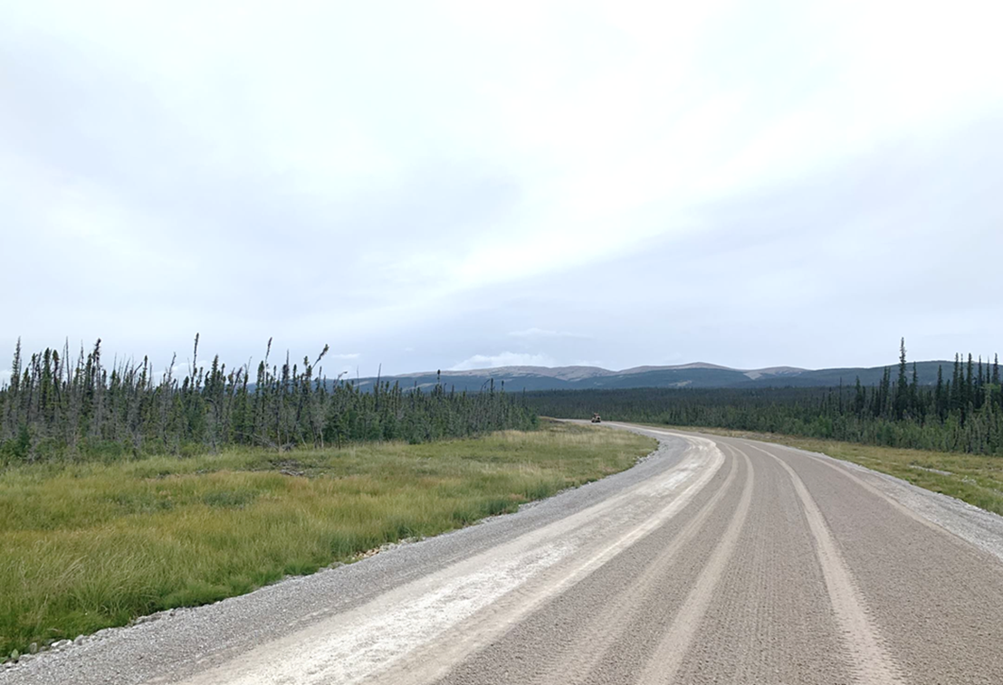
Agenda
GNWT Strategic Initiatives
Mackenzie Valley Highway at a Glance
Engagement Opportunities
Project Overview
Breakout Groups
Next Steps
Closure and Wrap Up

Slide 3
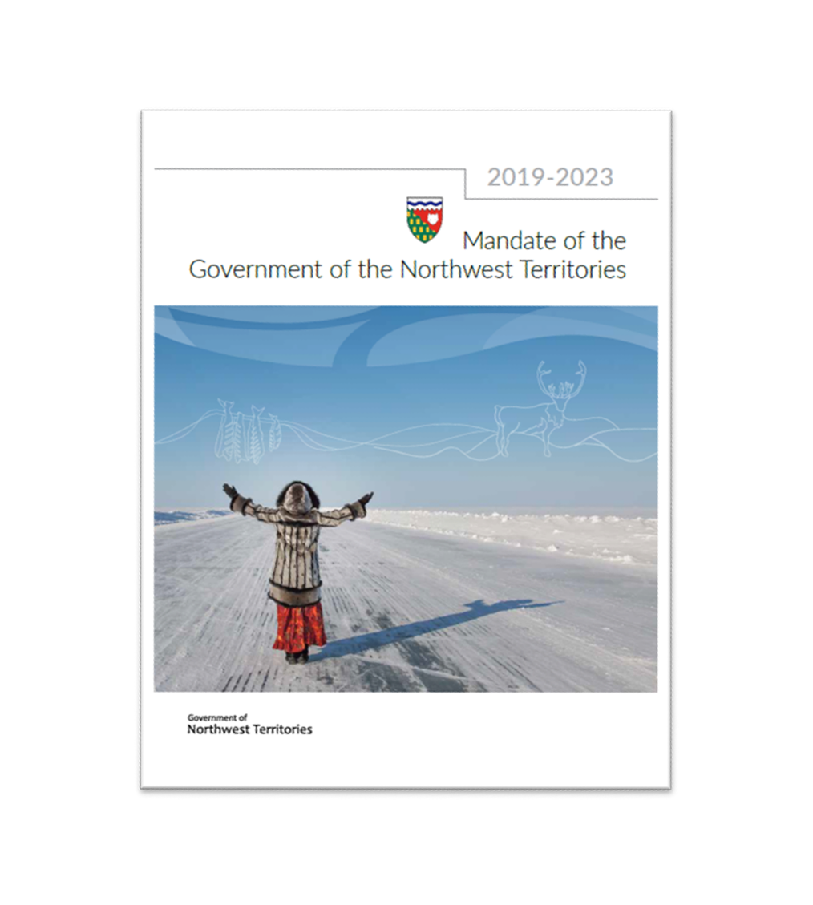
GNWT Strategic Initiatives
“These projects will provide the foundational infrastructure to support an improved quality of life and lower cost of living for NWT residents, as well as support the expansion and diversification of the economy.”
Mackenzie Valley Highway
Slave Geological Province Corridor
Taltson Hydro Expansion

Slide 4
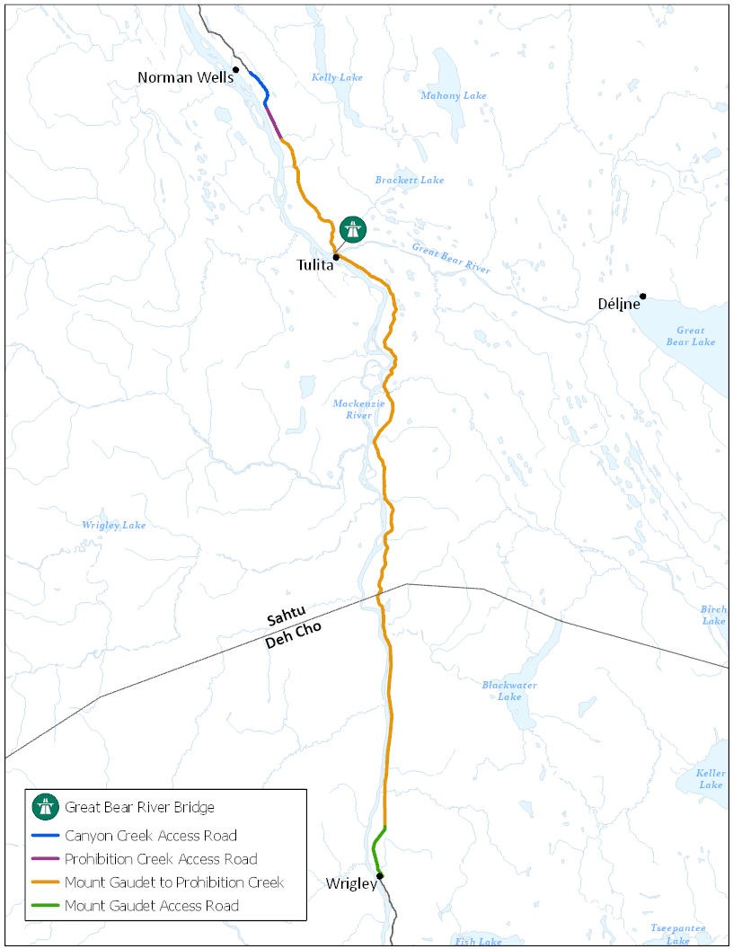
Mackenzie Valley Highway at a Glance
All-season road between Wrigley and Norman Wells
Mackenzie Valley Highway Environmental Assessment
  Developer’s Assessment Report
  Environmental and Engineering Studies
  Wildlife Related Studies
  Traditional Knowledge Studies
  Socio-Economic Impact Assessment

Slide 5
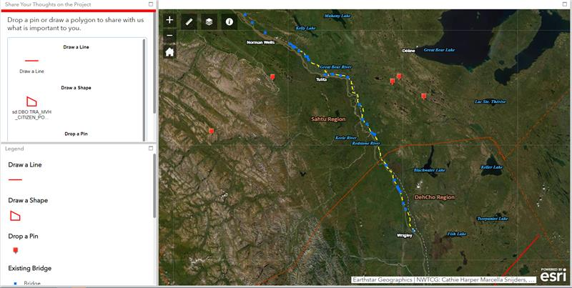
Engagement Opportunities
Community Workshops
One-on-One Meetings
Virtual Engagement Website
Interactive Map
Have Your Say: https://haveyoursay/nwt-tno-ca/Mackenzie-valley-highway-project

Slide 6
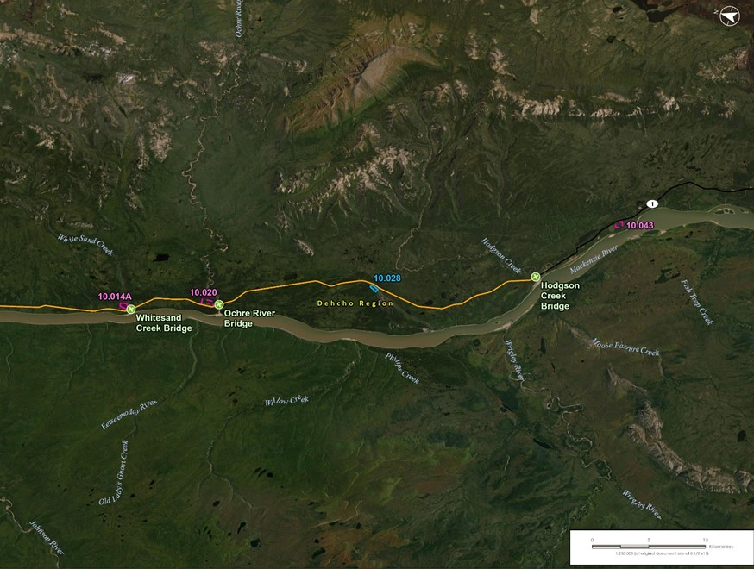
Project Overview
New two-lane public gravel road from Wrigley to Tulita and Norman Wells
To replace the Mackenzie Valley Winter Road
102 km in Dehcho Region
179 km in Sahtu Region

Slide 7
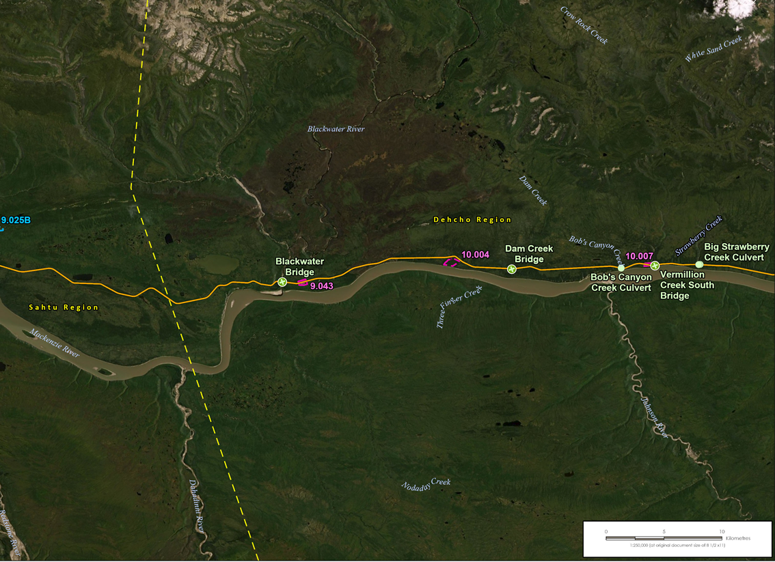
Project Overview
The highway will mostly follow the Mackenzie Valley Winter Road
The highway will connect to existing bridges on the Mackenzie Valley Winter Road
New culverts will be built to cross other watercourses

Slide 8
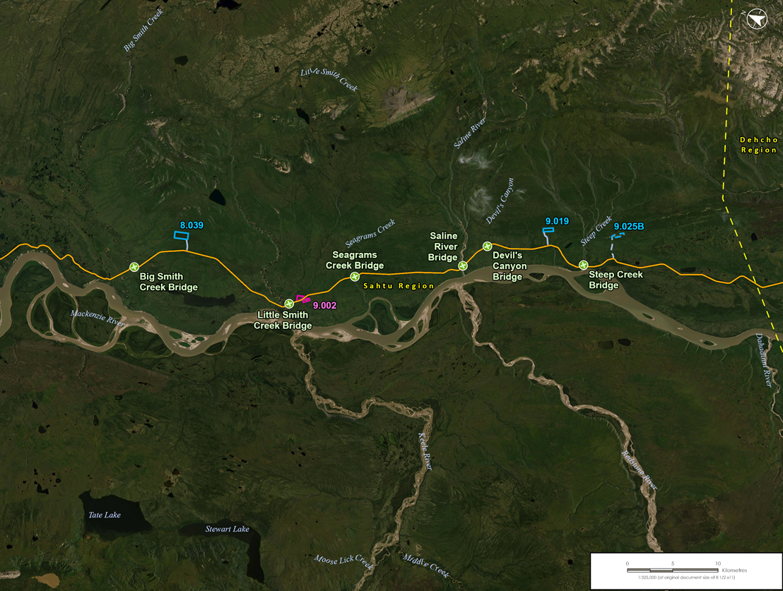
Project Overview
Approximately 15 material sources will be needed: quarries (rock) and borrow sources (gravel and sand material)
Some will require new all-season access roads
Some will become permanent sources for highway maintenance
Some sources have been partly developed previously

Slide 9
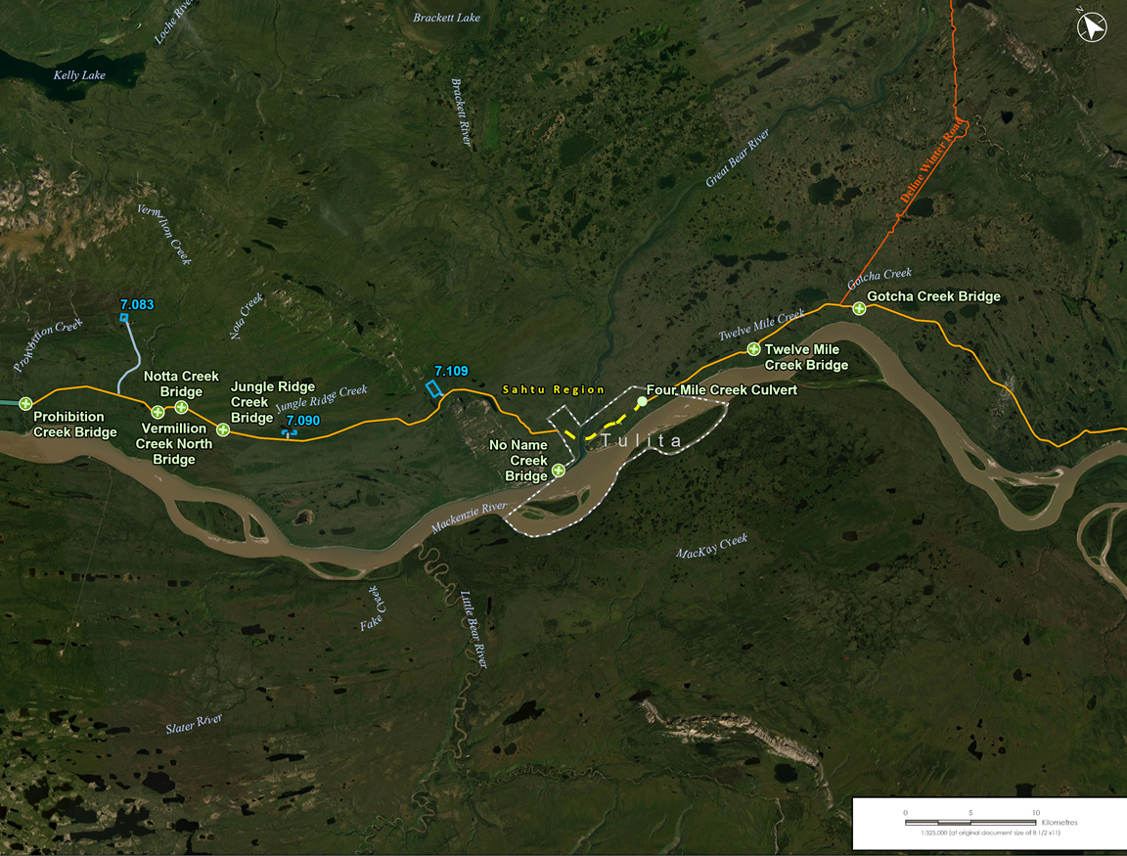
Project Overview
The Project will:
Build and use temporary construction camps and workspaces
Use water for camp use, construction and dust control
Construct permanent maintenance yards

Slide 10
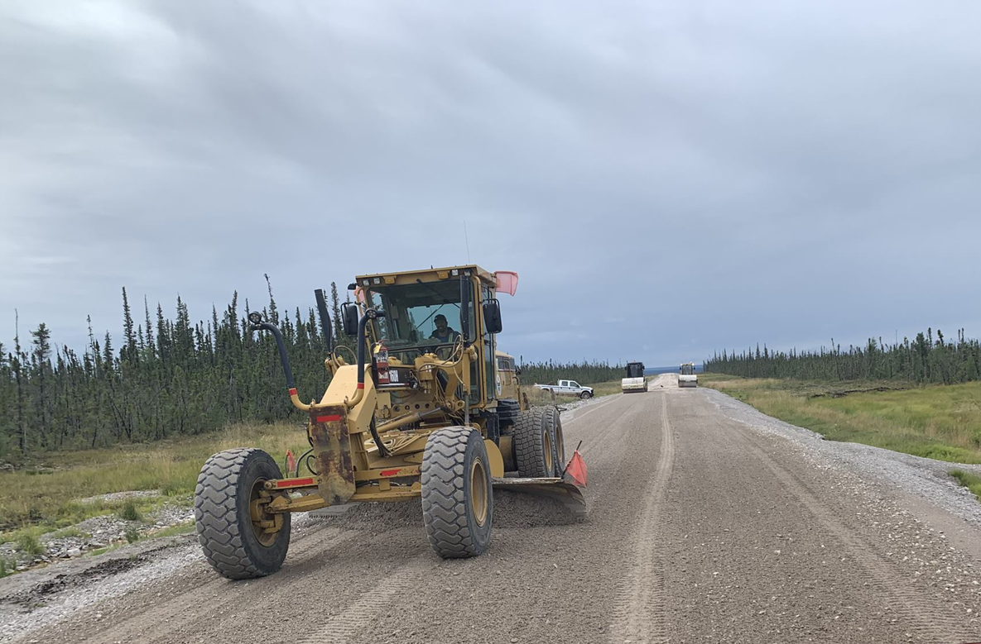
Project Activities
Once open, GNWT anticipates traffic of 50 vehicles per day
Highway maintenance will require ongoing quarry operations (9 sources)
Highway maintenance will require water use for dust control (sources to be determined)

Slide 11
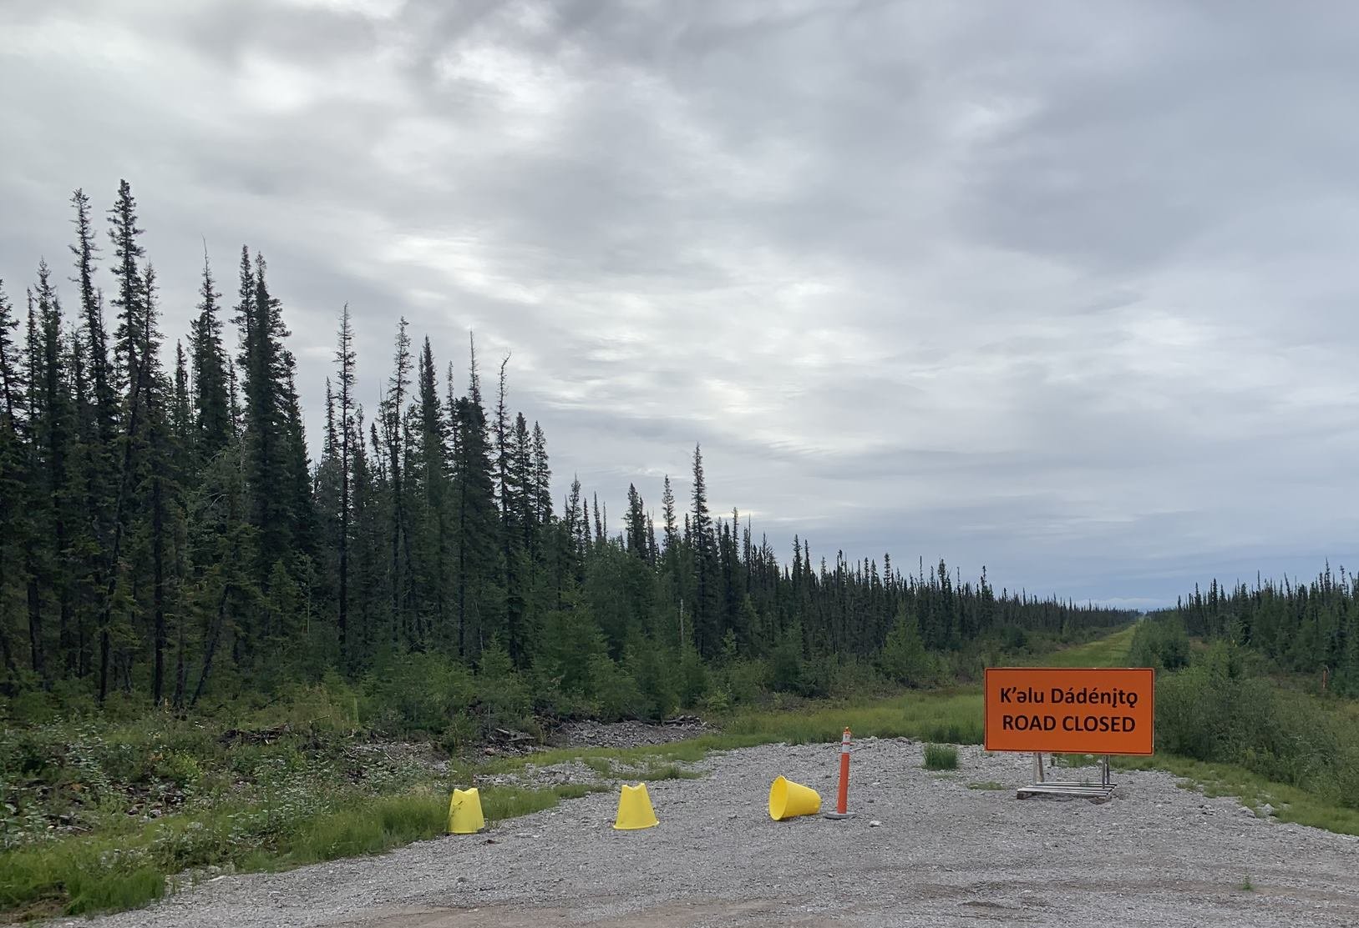
Proposed Mackenzie Valley Highway Route
Design Principles
Follow winter road as much as possible
Avoid certain terrain such as wet areas
Connect to existing bridges
Meet design criteria for safety and use
Proposed Routing Corridor
Design is at early stage
1 kilometre wide corridor
The final highway route will be in this corridor
From GNWT-INF Canyon Creek All-Season Access Road

Slide 12
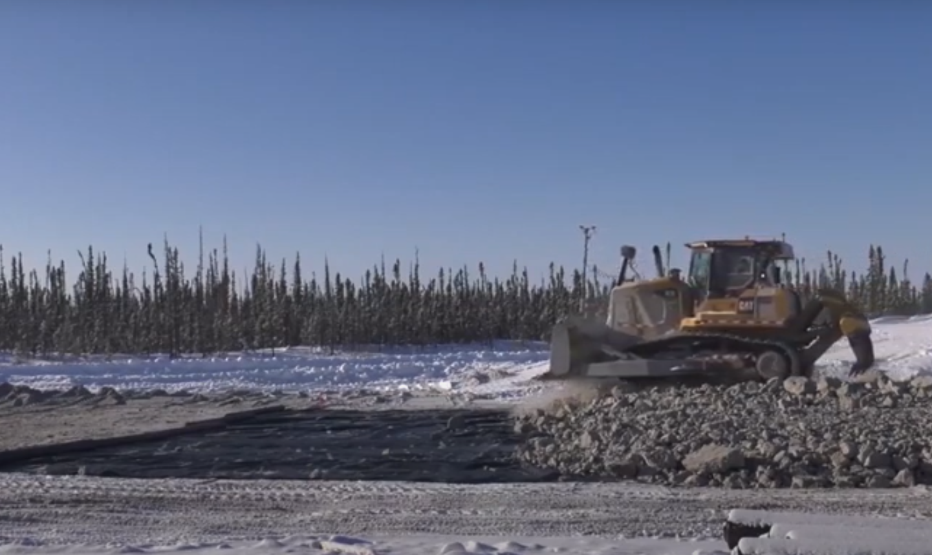
Project Activities
Mobilization and Staging of equipment, fuel and materials
winter road
barge
Clearing of Right-of-Way
Widening from 30 m to 60 m
Or, new right-of-way
All clearing in winter
Road Cuts into the tops of hills may be needed at steep valley approaches
From GNWT-INF Canyon Creek All-Season Access Road

Slide 13
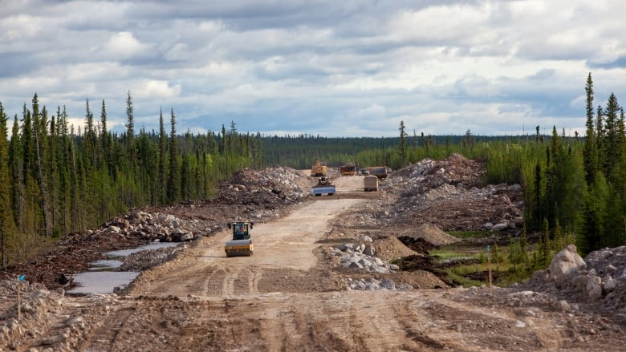
Project Activities
Building the roadway
Place rock material “embankment” on ground surface (winter)
Place “road base” and compacting (summer and winter)
Culvert installation
Approximately 85 culverts
Designed to maintain flows and fish passage
Will be installed in summer
May need to clear beaver dams
Source: CBC article Phot Bill Braden/GNWT Dept. of Infrastructure)

Slide 14
Breakout Session #1
Right-of-way, alignment, road location and design, culverts and drainage
Guiding Questions
What are your thoughts on the road location and design?
What do you think about road cuts in steep valleys? Are there any concerns or recommendations?
Are there any places where the road should or should not be?
Are there any concerns or recommendations about the road near Bear Rock?
How do you access harvesting areas right now?

Slide 15
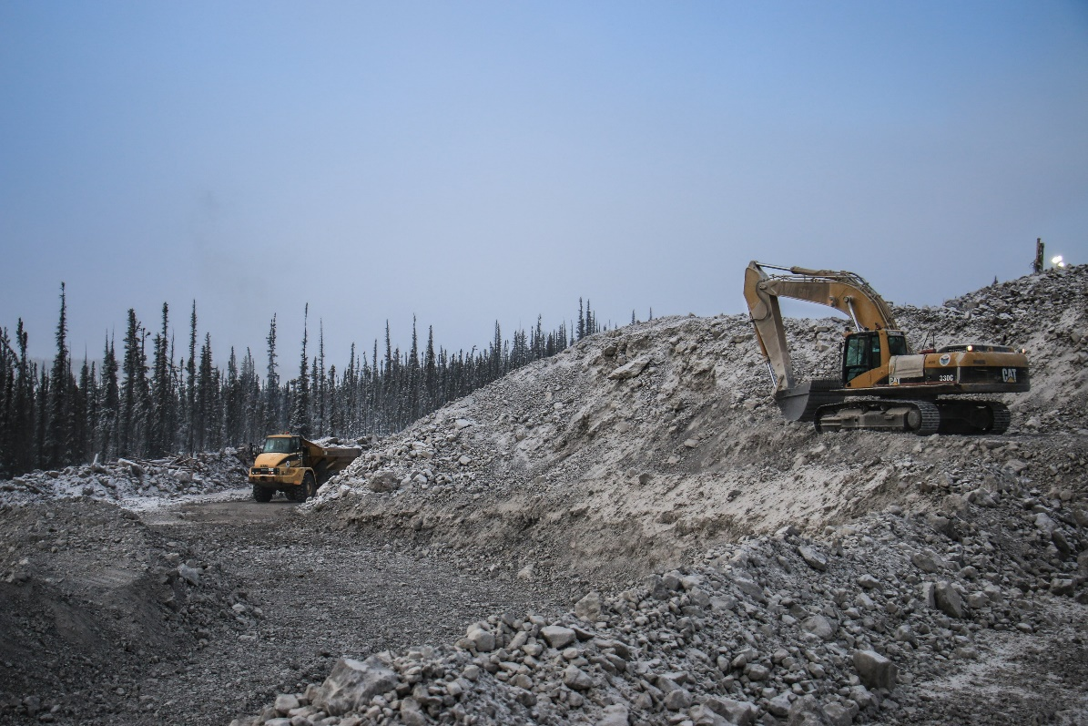
Project Activities
Quarries
Blasting
Crushing
Material stockpiles
Borrow Sources
Excavation
Material stockpiles
Access Roads
30 m wide right-of-way
Built to be used year-round
From GNWT Northern Land Use Guidelines

Slide 16
Breakout Session #2
Quarries, borrow sources, and access roads
Guiding Questions
What are your thoughts on the number and location of borrow sources and quarries?
Is there anything we should know about moose, caribou, or harvesting when thinking about the proposed quarries, borrow sources, or access roads?
Are there any of these new roads in locations where you access harvesting areas right now?
Will the roads help or make harvesting more difficult for you?

Slide 17
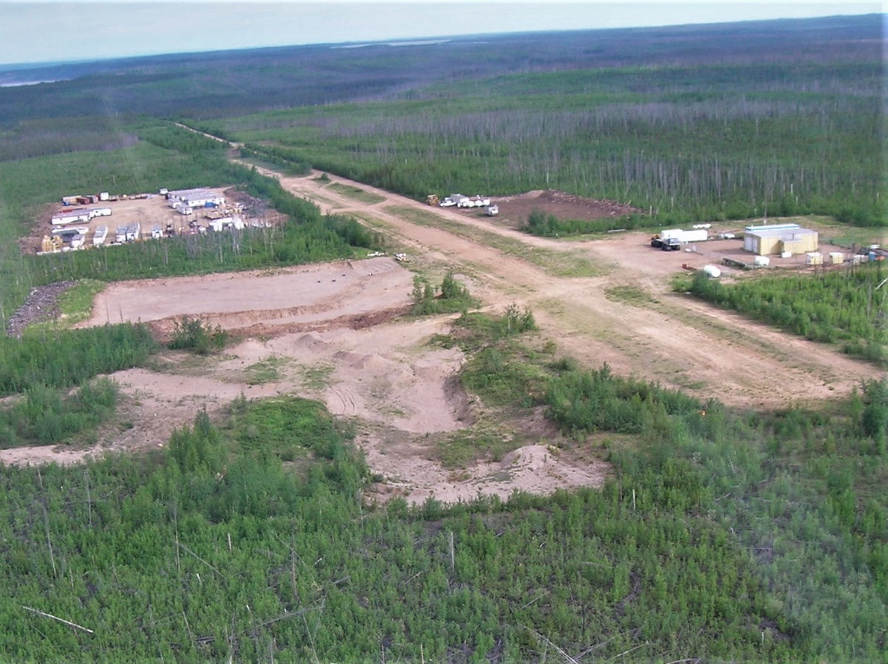
Project Activities
Camps
Estimated 40-70 persons
Potential locations:
  Existing camp facilities (e.g., Norman Wells)
  New locations within municipal boundaries
  At or near one or more borrow sources or quarries
Waste Management
Domestic waste and sewage disposed to municipal facilities
Greywater to municipal facilities
Source: https://spectacularnwt.com/destinations/sahtu/tulita

Slide 18
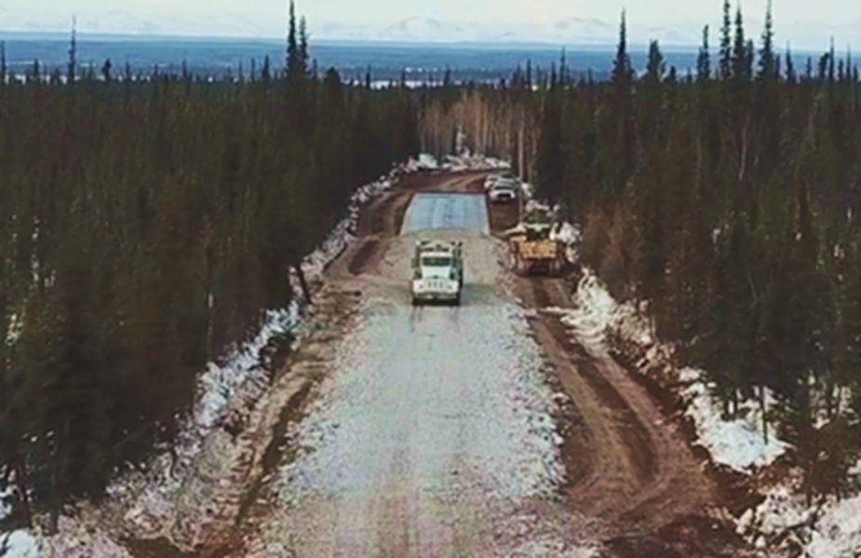
Project Activities
Water Use
Camp operations (year-round)
Road compaction (summer)
Dust control (summer)
Build a winter travel lane where needed (winter)
Water Sources
Mackenzie River
Many of the same sources used to build the winter road
Source: https://spectacularnwt.com/destinations/sahtu/norman-wells

Slide 19
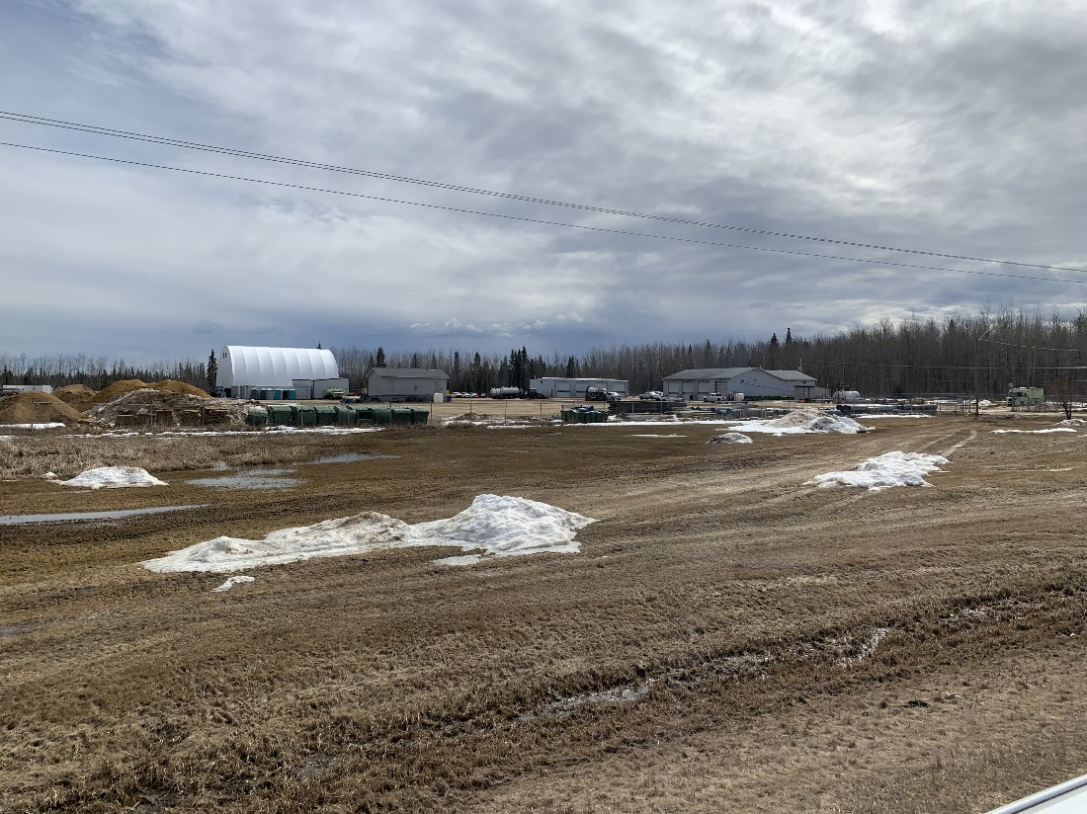
Project Activities
Maintenance Yards
Support operations and maintenance of the highway once built
May be located at borrow sources close to the highway
Garage, equipment, fuel, material stockpile

Slide 20
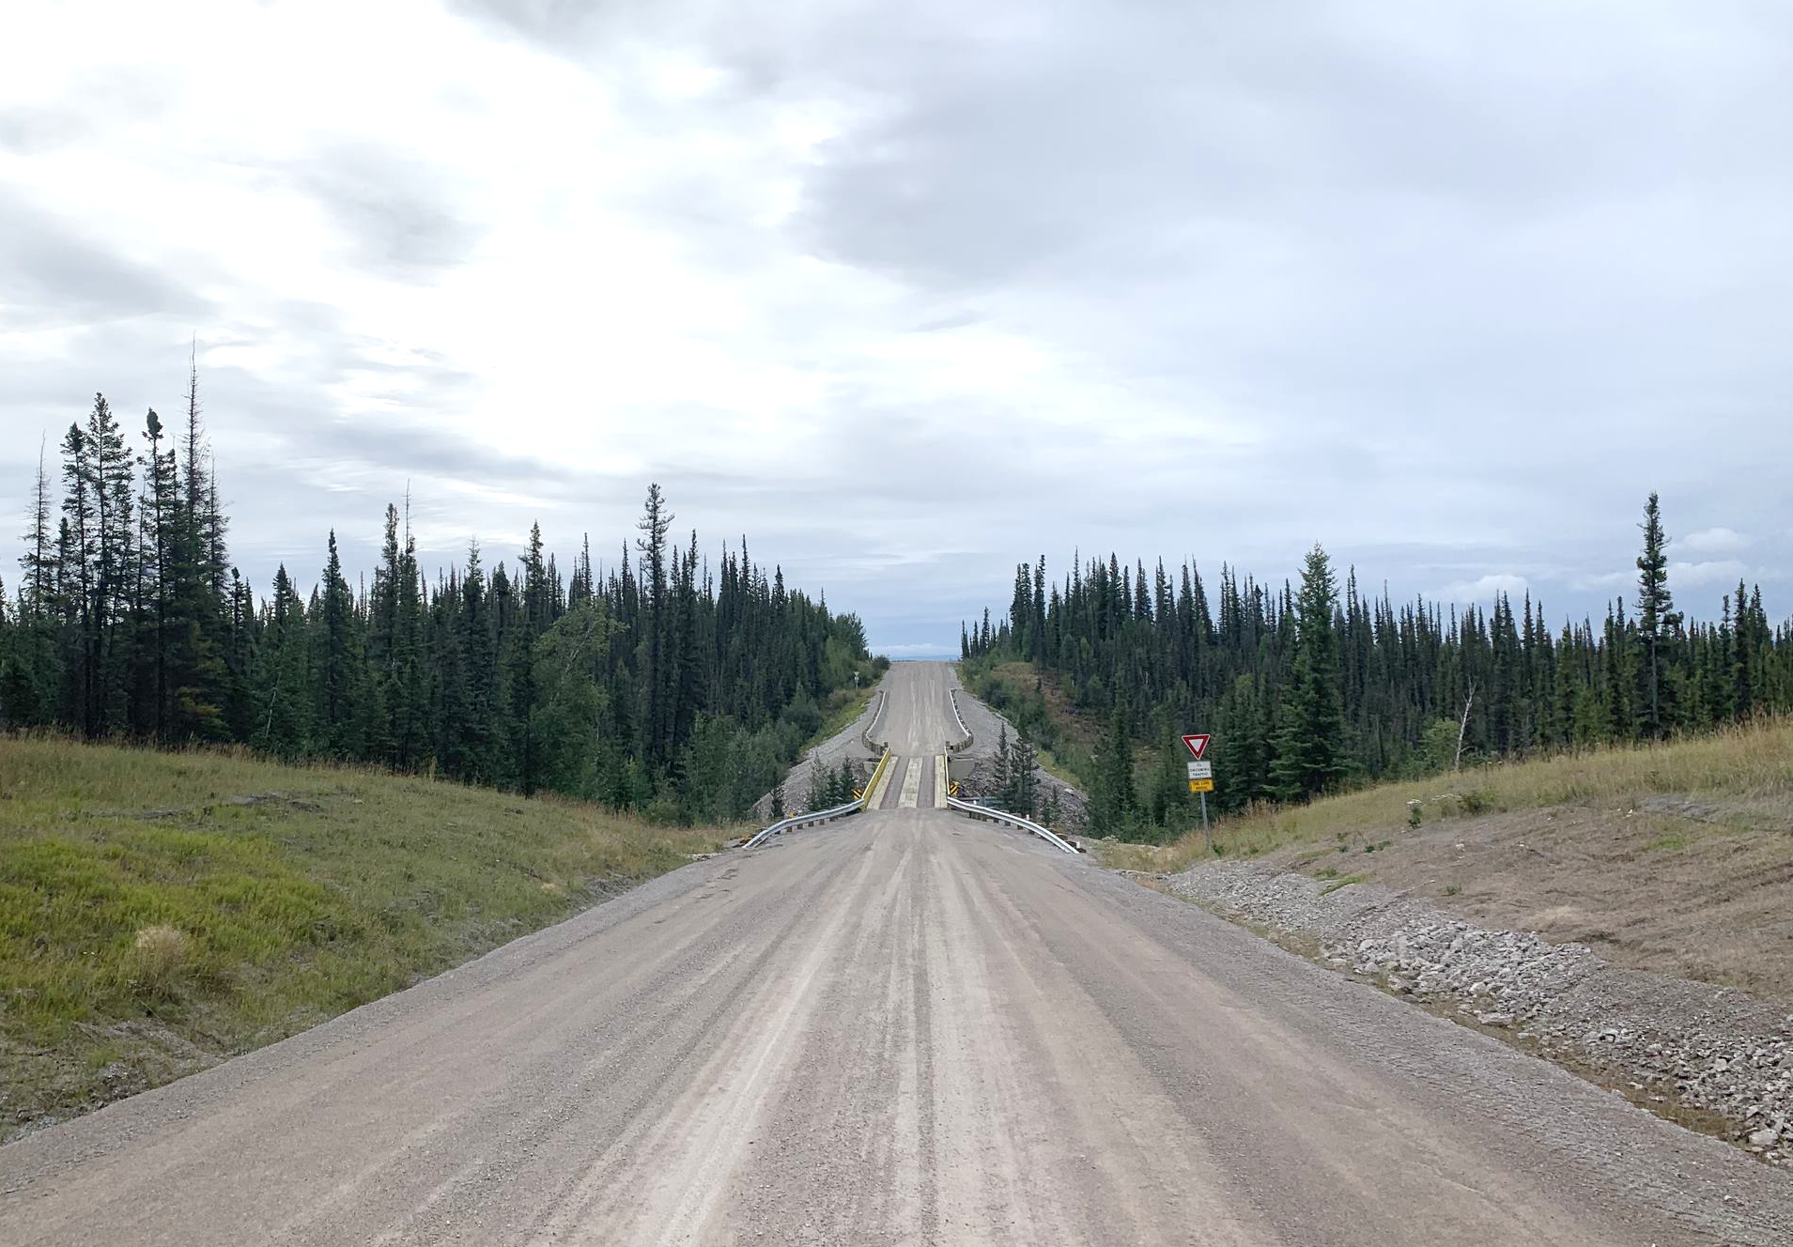
Project Activities
Reclamation after construction
Remove equipment and materials
Promote drainage and reduce erosion potential
No active revegetation

Slide 21
Breakout Session #3
Camps, laydown areas, water use, waste management, maintenance yards, and reclamation after construction
Guiding Questions
Do people have any locations they would recommend for potential camps (temporary), maintenance yards (permanent), or laydown areas (temporary)?
How do people feel about taking the camp wastes to the community landfill and lagoon?
Do you know which creeks flow year-round and might make good water sources?
Are there concerns around water use for building short sections of access or for dust control?

Slide 22
Next Steps
2022
2023
2024
Environmental and Engineering Studies
Developer’s Assessment Report Submission
Engagement and Consultation
Review Board Process
Information Requests
Environmental and Engineering Studies
Technical Sessions
Interventions
Public Hearings and Follow Up
Report of Environmental Assessment
Responsible Minister’s Final Decision

Slide 23
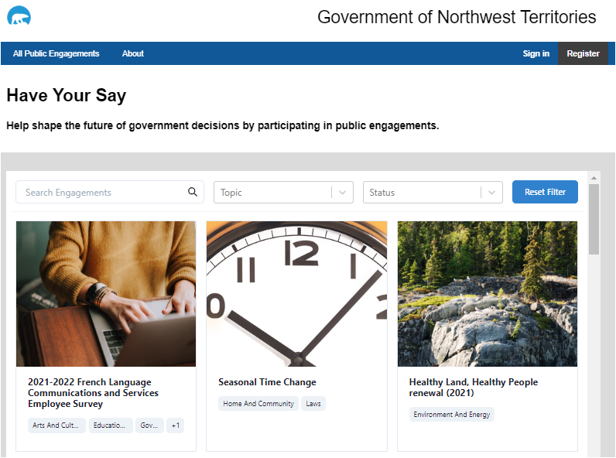
Upcoming Engagement Opportunities 2022
Have Your Say Website
  Interactive Map, Comments and Question Box, Links to Project Information
April 2022
  Engagement: MVH Project Design (Four Workshops)
Summer 2022
  Engagement: MVH Potential Effects and Mitigations
Fall 2022
  What We Heard Report
  Developer’s Assessment Report

Slide 24
Questions?
Email: MVH@gov.nt.ca
Project Website: www.inf.gov.nt.ca/en/MVH
Have Your Say: https://haveyoursay/nwt-tno-ca/Mackenzie-valley-highway-project

