Slide 1
Mackenzie Valley Highway Project
City of Yellowknife Major Project Update
May 2025

Slide 2
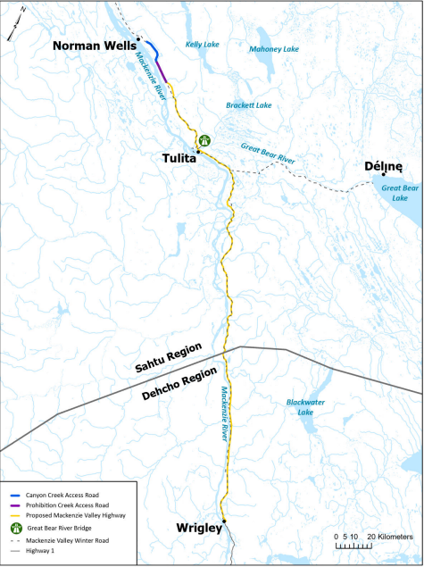
Project Overview
New two-lane gravel road from Wrigley to Tulita and Norman Wells to replace the Mackenzie Valley Winter Road
  3 Segments
  10 years to construct over ~20 years
Protect supply chains and stabilize cost of living through climate-resilient infrastructure
Diversify the NWT economy through resource development, remediation, and tourism sectors
Provide a crucial lifeline for residents during emergencies through all-season road access

Slide 3
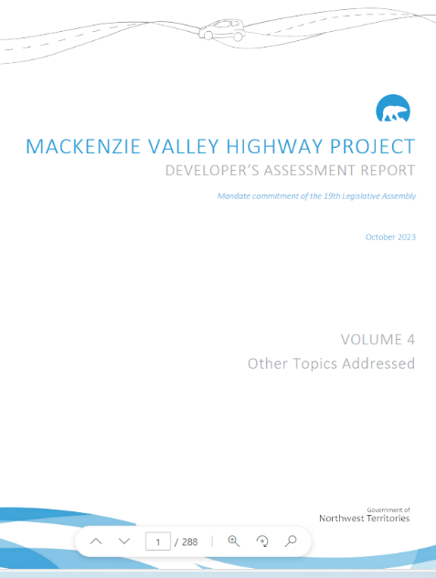
Developer’s Assessment Report (DAR)
  Presents detailed information required to evaluate the project through the Environmental Assessment process
  Potential interactions between the Project and the environment that could lead to changes (potential effects)
  Proposed mitigation measures to reduce potential adverse effects
  Predicting the effects on the environment after mitigation actions are taken (residual effects)

Slide 4
Notable Findings of the Assessment
General sentiment is positive
Significant adverse socio-economic effects
  Increased availability of drugs and alcohol
  Public safety (road incidents)
Significant adverse biophysical effects
  The Project will reduce boreal caribou habitat, and the amount of existing disturbance is already significant.
  The Project will make it easier to harvest fish and may lead to overfishing (conservatively significant)

Slide 5
Current Status
Analytical Phase
Review Board issues Report of Environmental Assessment
Public Review of DAR – Jan – Feb 29, 2024
Round 1 Information Requests (IRs) from Review Board – March 2024
Developers Response to Public Comment (ORS) – April 19, 2024
Developers Response to Review Board and Party IRs – September 27, 2024
Hearings – Mid-late 2025
Minister(s) response to Report of Environmental Assessment
Prehearing Conference
Closure of the Public Record
Decisions
Community Sessions – October 2024
Developers Response to Round 2 IRs – June 2025
DAR Addendums Submitted to Review Board – Summer 2025
Interventions
Developer Response to Interventions
Public Hearings
Hearing Undertakings
Closing Arguments from Parties
Closing Arguments from Developer
Review Board evidence analysis, deliberation, report drafting & legal and editorial reviews
MVEIRB DRAFT ENVIRONMENTAL ASSESSMENT SCHEDULE
Technical Sessions – November 2024
  Technical Sessions were held in Yellowknife from November 19-21, 2024
  Review Board has carried out public engagement and Community Sessions in the Dehcho and Sahtu Regions throughout 2024 and 2025
  GNWT has responded to questions:
    141 Comments from the Online Review System
    158 Round 1 Information Requests (IRs)
    135 Round 2 IRs (110 complete as of May 12, 2025)

Slide 6
Next Steps
2025
2026
2027 – 20XX
Review Board Public Hearings and Follow up
Report of Environmental Assessment
Federal Lobbying for Construction Funding
Engagement and Indigenous Consultation
Mitigation Engagement and Planning
Engineering & Design studies
Responsible Ministers’ Final Decision
Application for Construction Regulatory Authorizations
Engagement and Indigenous Consultation
Federal Lobbying for Construction Funding
Procurement (Pending Funding)
Engineering & Design studies
Start Construction (Pending Regulatory Authorizations & Funding)
Engagement and Indigenous Consultation
Construction & Construction Monitoring

Slide 7
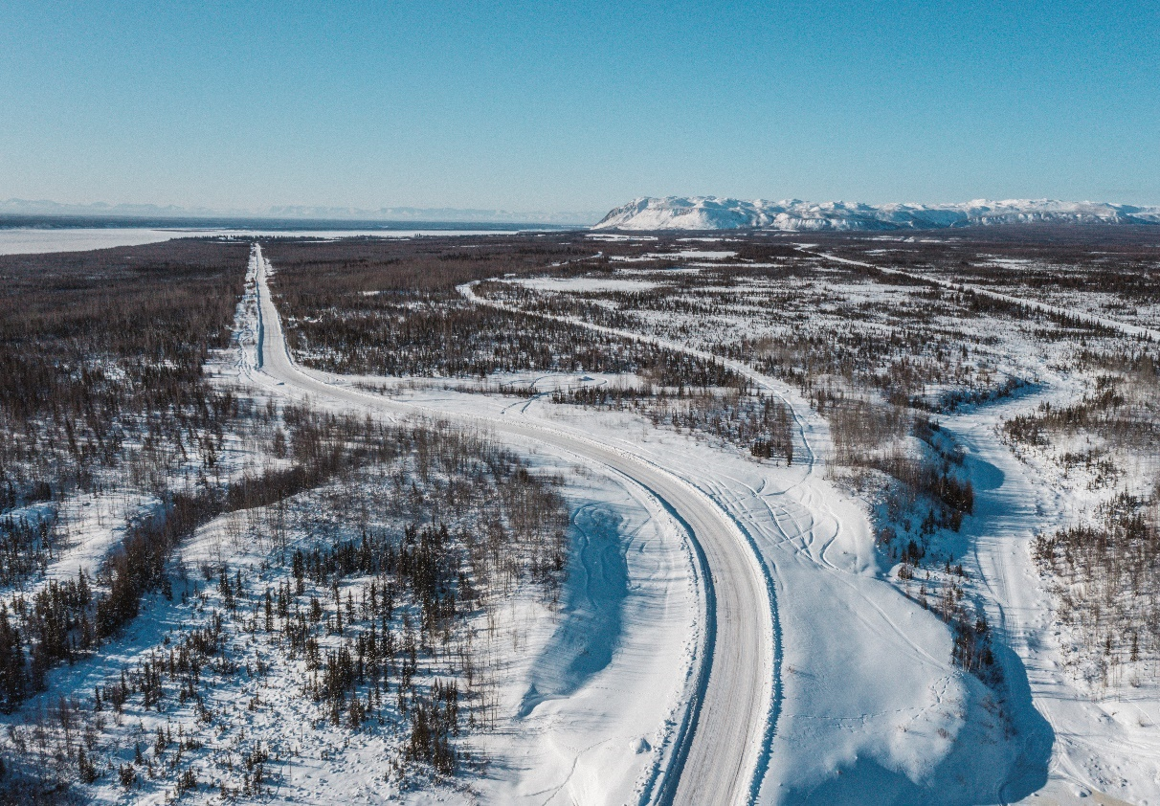
Questions?
Email:
MVH@gov.nt.ca
Project Website: www.inf.gov.nt.ca/en/MVH
Mackenzie Valley Highway EA: https://reviewboard.ca/registry/ea1213-02

