Slide 1
Mackenzie Valley Highway Project
Mackenzie Valley Environmental Impact Review Board Community Sessions
October 2024

Slide 2
Mackenzie Valley Highway
The Government of the Northwest Territories (GNWT)
is the DEVELOPER
Improve inter-community mobility and accessibility by establishing a reliable transportation corridor in the Mackenzie Valley
Protect supply chains and stabilize cost of living through climate-resilient infrastructure
Boost the local economy and create new jobs during the project construction, operation, and maintenance phases
Diversify the NWT economy through resource development, remediation, and tourism sectors
Provide a crucial lifeline for residents during emergencies through all-season road access

Slide 3
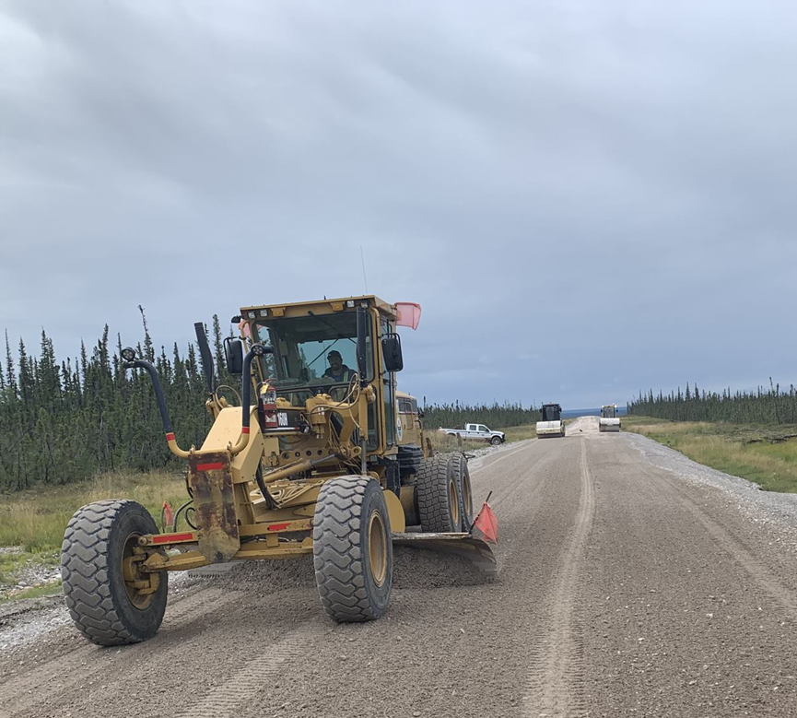
Project Overview
New two-lane gravel road from Wrigley to Tulita and Norman Wells to replace the Mackenzie Valley Winter Road
The MVH will mostly follow the Mackenzie Valley Winter Road and connect to existing bridges, within 1 km corridor
  Construction Schedule
  3 construction segments
  10 years to construct over ~20 years
Notes:
102 km in Dehcho Region
179 km in Sahtu Region

Slide 4
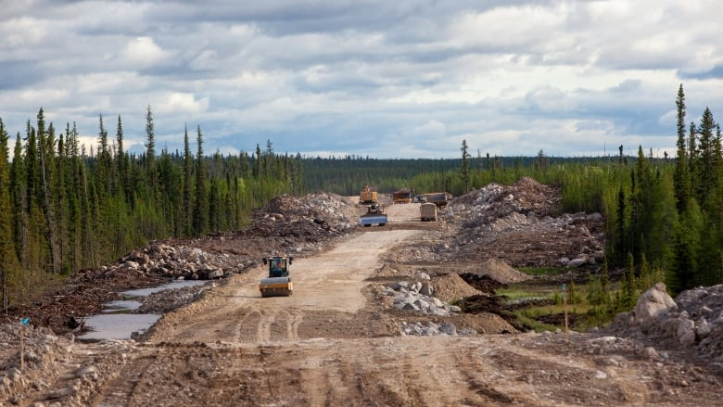
Project Overview
Project Activities
Mobilization and Staging of Equipment, Fuel and Materials
Establishment of Construction Camps
Clearing/Widening of Right-of-Way
Development of Borrow Sources/Quarries
Use water for camp use, construction and dust control
Road Construction / Material Placement
Additional watercourse crossing structures (culverts)
Construct permanent maintenance yards
Notes:
The route will mostly follow the existing Mackenzie Valley Winter Road, connecting by existing bridges. Additional culverts, quarries and borrow sources will also need to be developed, and temporary Infrastructure and workspaces, such as camps and laydown areas will be required during construction. After construction, there will be ongoing highway and operations as they highway becomes part of the NWT highway system.

Slide 5
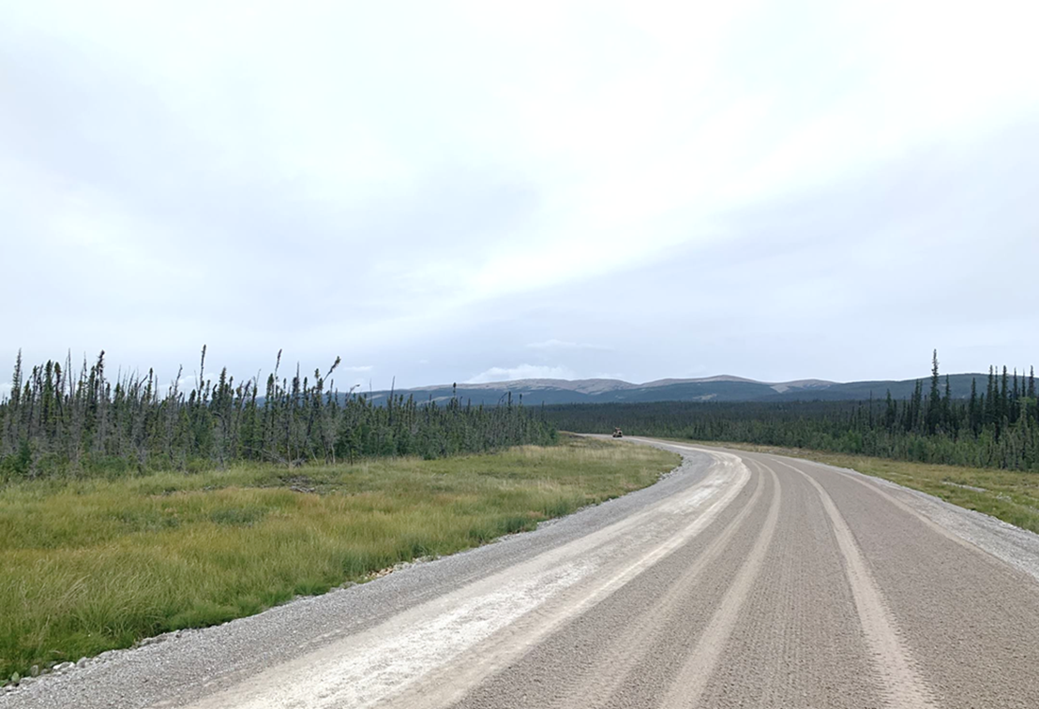
Project Activities
Once open, GNWT anticipates traffic of 50 vehicles per day
Highway maintenance will require ongoing quarry operations (9 sources)
Highway maintenance will require water use for dust control (sources to be determined)
Notes:
Once the highway is opened from end-to-end, GNWT anticipates traffic of about 50 vehicles per day. This is about the same as the current winter road, but it will be year-round.
Some of the ongoing maintenance of the road will require GNWT to continue to operate some of the quarries and borrow sources to source material, and to use water for dust control.
There are currently 9 sources identified as permanent material sources.
This photo shows how crushed material is used to maintain the highway.

Slide 6
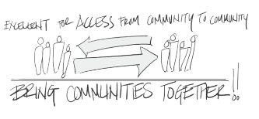
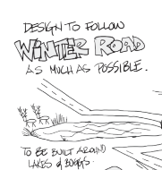
Engagement and Traditional Knowledge
      2010-2012 - Project Description Reports
      2018-2020 - Project Updates
      2021-2023 – Developer’s Assessment Report
        Project description and construction activities
        Potential project interactions and effects
        Mitigation and monitoring
      Traditional Knowledge Studies:
        Tulita Renewable Resources Council
        Norman Wells Renewable Resources Council
Notes:
Engagement on the project has been ongoing for many years. Extensively during the development of the Project Description reports between 2010 and 2012, and more recently, during the development of the DAR.
Between 2021 and 2023, the GNWT conducted three rounds of engagement in affected communities, to present a Project overview; to present and discuss potential interactions and effects of the project on the environment; and during a third round, to present and discuss proposed mitigation measures and monitoring program. The influence of engagement on the project and effects assessment is presented throughout the DAR.
Although we heard a wide variety of input, we received the most input on the Project route, special places, and potential impacts to communities. We heard concerns about increased access to drugs and alcohol, concerns about harvest pressures, and interest in employment opportunities and training.
Project specific traditional knowledge studies were completed by the Tulita Renewable Resources Council and Norman Wells Renewable Resources Council.

Slide 7
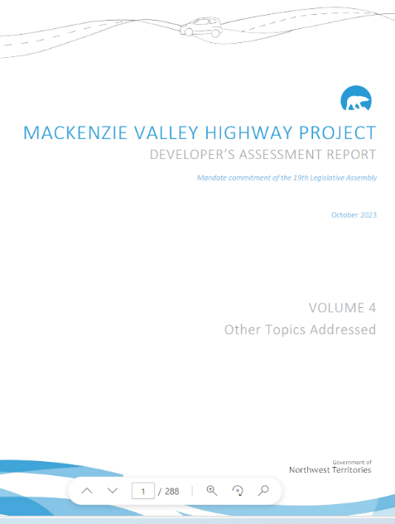
Developer’s Assessment Report (DAR)
  Presents detailed information required to evaluate the project through the Environmental Assessment process
  Potential interactions between the Project and the environment that could lead to changes (potential effects)
  Proposed mitigation measures to reduce potential adverse effects
  Predicting the effects on the environment after mitigation actions are taken (residual effects)
  Summarized in Non-technical Summary
Notes:
What is a Developer’s Assessment Report. The GNWT was required by the Mackenzie Valley Environmental Impact Review Board to submit a Developer’s Assessment Report (DAR). The DAR needs to assess how the project will affect – or change the environment, which includes people, communities, economy, and natural resources. The GNWT needs to also look at whether these changes will be significant.
The DAR predicts how the Project will affect different parts of the environment by:
identifying potential interactions between the Project and the environment that could lead to changes (potential effects)
-then identifying ways to reduce potential negative effects (we call these mitigation measures)
-and then predicting what will be the changes to these parts of the environment after mitigation actions are taken (we call these residual effects)
finally, the DAR identifies if the residual effects are significant – which is defined for each part of the environment.
The findings of the assessment are summarized in the non-technical summary, which we have copies of here today.

Slide 8
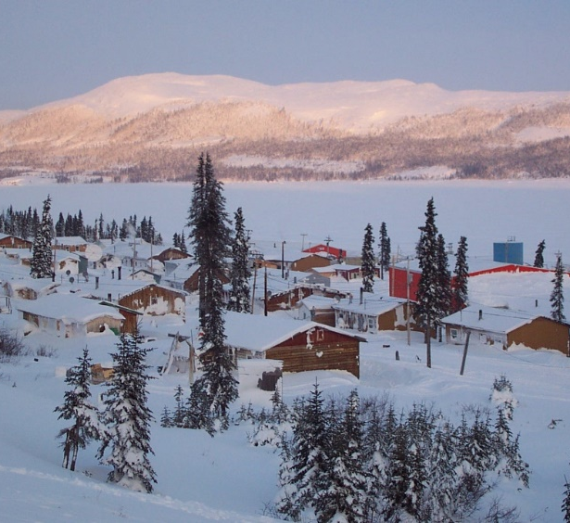
Notable Findings of the Assessment
General sentiment is positive
Many positive socio-economic effects
Communities want to be prepared
Most socio-economic effects are not significant when mitigation measures are applied
Significant adverse socio-economic effects
  Increased availability of drugs and alcohol
  Public safety (road incidents)
New and ongoing collaborative monitoring and management of these effects will be required.
Notes:
Engagement activities, interviews and focus groups found that communities want to be prepared for the Project.
Mitigation measures will be important to reduce adverse project effects so they are not significant.
A Community Readiness Strategy has been proposed to identify specific socio-economic mitigation measures and GNWT commitments. The strategy is intended to reduce adverse socio-economic project effects and enhance positive project effects. The foundation of the approach to community readiness is continued engagement, and collaboration.
There are anticipated to be two significant adverse socio-economic effects. This means that even with mitigation measures, the adverse effects are going to be noticeable in communities.
One is the increased availability of drugs and alcohol, which is anticipated to increase social pressures in communities and add to an already serious issue for many communities.
The other is related to impacts on public safety – it is anticipated that the Project will change safety levels, especially for vulnerable populations, and through increased potential for incidents on the road.

Slide 9
Notable Findings of the Assessment
Mitigation measures are expected to be effective at preventing significant effects to air quality, noise, soils and permafrost, vegetation, most wildlife, birds and water.
The Project will improve access to harvesting and traditional land use areas.
The Project will reduce boreal caribou habitat, and the amount of existing disturbance is already significant.
The Project will make it easier to harvest fish and may lead to overfishing (conservatively significant)
Notes:
Similarly, mitigation measures are expected to be effective at preventing significant effects to air quality, noise, soils and permafrost, vegetation, most wildlife, birds and water.
The assessment concluded that the project will further reduce boreal caribou habitat, which will contribute to an existing habitat condition which is already significant.
The project will make it easier to harvest fish and may lead to overfishing of certain fish species. There is a lot of uncertainty regarding this prediction, and so the effect is conservatively assessed as significant.
These effects will need to be carefully watched.

Slide 10
Review Board Process
Analytical Phase
Review Board issues Report of Environmental Assessment
Public Review of DAR – Jan – Feb 29, 2024
Round 1 Information Requests (IRs) from Review Board – March 2024
Developers Response to Public Comment (ORS) – April 19, 2024
Developers Response to Review Board and Party IRs – September 27, 2024
Hearings – Early-Mid 2025
Minister(s) response to Report of Environmental Assessment
Prehearing Conference
Closure of the Public Record
Decisions
Community Sessions – October 2024
IRs Round 2 – Late 2024
Developers Response to Round 2 IRs – Early 2025
DAR Addendums Submitted to Review Board – Spring 2025
Interventions
Developer Response to Interventions
Public Hearings
Hearing Undertakings
Closing Arguments from Parties
Closing Arguments from Developer
Review Board evidence analysis, deliberation, report drafting & legal and editorial reviews
MVEIRB DRAFT ENVIRONMENTAL ASSESSMENT SCHEDULE
Technical Sessions – November 2024
Currently in Analytical Phase of EA
Since submission of the DAR:
  GNWT has responded to questions:
    141 comments from the Public Review
    158 Information Requests (IRs)
  Review Board has carried out public engagement in the Dehcho Region and Sahtu Regions
Notes:
Similar to what the board stated in their presentation, the purpose of the session today is to hear from community members about your thoughts on how we can work together to make the project better.
Environmental assessment is now in the Analytical Phase – involves information requests, technical and community sessions and eventually a public hearing <<refer to slide for MVEIRB draft workplan dates>>
The DAR was confirmed to be in conformity with the Terms of Reference
GNWT received and responded to questions from the Review Board and parties
MVEIRB carried out engagement to inform communities about their process - invited INF to attend
At the request of PKFN leadership, INF did not attend the session in Wrigley in February
GNWT attended in Fort Simpson (February) and Norman Wells and Tulita (April)

Slide 11
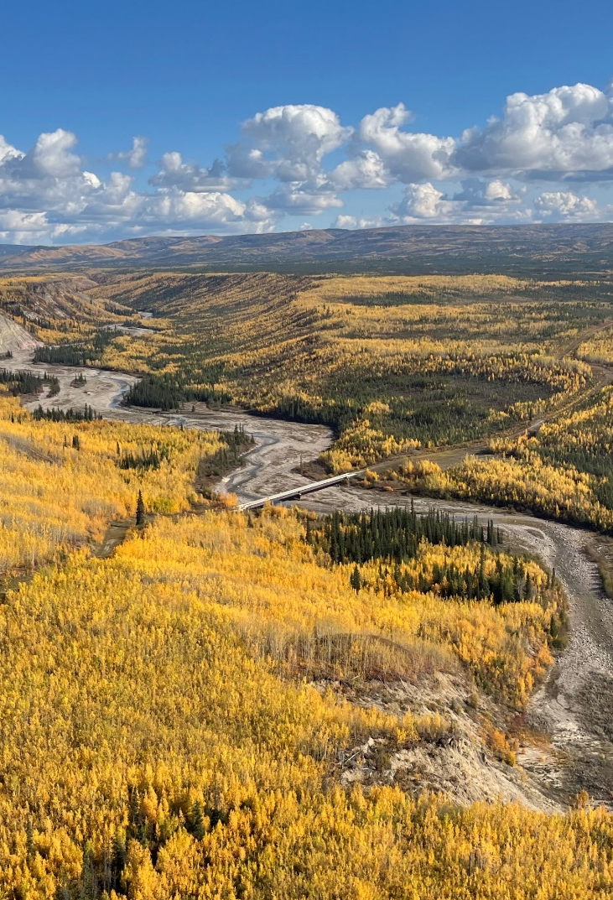
Themes of IRs Received
Construction schedule and duration
Alternative construction schedule proposed and qualitatively assessed
Engineering and design
Detailed design will be completed after the environmental assessment
Traditional Knowledge
Traditional Knowledge has and will continue to guide and inform the project
Notes:
related to Timing and logistics of socio-economic mitigations, and community readiness and how communities will participate in monitoring

Slide 12
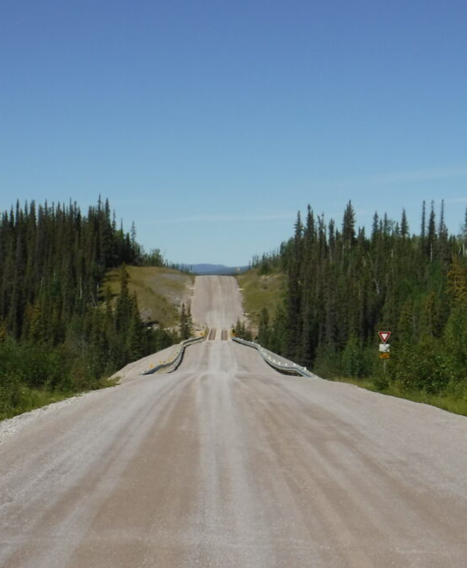
Themes of IRs Received
Potential biophysical and socio-economic effects related to the project
The GNWT will continue to engage on the Community Readiness Strategy and the Wildlife Management and Monitoring Plan
Prediction certainty in a changing climate
Collaborative and adaptive management and monitoring allows flexibility
Mitigation related concerns
  Timing and logistics of socio-economic mitigations, and community readiness
  Community participation in monitoring
Notes:
related to Timing and logistics of socio-economic mitigations, and community readiness and how communities will participate in monitoring

Slide 13
Next Steps
2024
2025
2026
2027 – 20XX
Environmental Assessment Review Board Analytical Phase
Engineering & Design studies
TK studies
Engagement and Indigenous Consultation
Mitigation Engagement and Planning
Review Board Public Hearings and Follow up
Report of Environmental Assessment
Federal Lobbying for Construction Funding
Engagement and Indigenous Consultation
Mitigation Engagement and Planning
Engineering & Design studies
Responsible Ministers’ Final Decision
Application for Construction Regulatory Authorizations
Engagement and Indigenous Consultation
Federal Lobbying for Construction Funding
Procurement (Pending Funding)
Engineering & Design studies
Start Construction (Pending Regulatory Authorizations & Funding)
Engagement and Indigenous Consultation
Construction & Construction Monitoring
Notes:
The Review Board is conducting a public review of the information presented in the Developer’s Assessment Report.
In the meantime, the GNWT continues to prepare for the project:
-The GNWT is engaging with Indigenous Governments, Indigenous Organizations and other affected parties
-The GNWT has started detailed technical studies that will be used to complete the project design
The outcomes of the Review Board’s assessment and the Ministers’ final decision on the environmental assessment of the Project will be used by the GNWT to lobby the federal government for funding to construct the project.

Slide 14
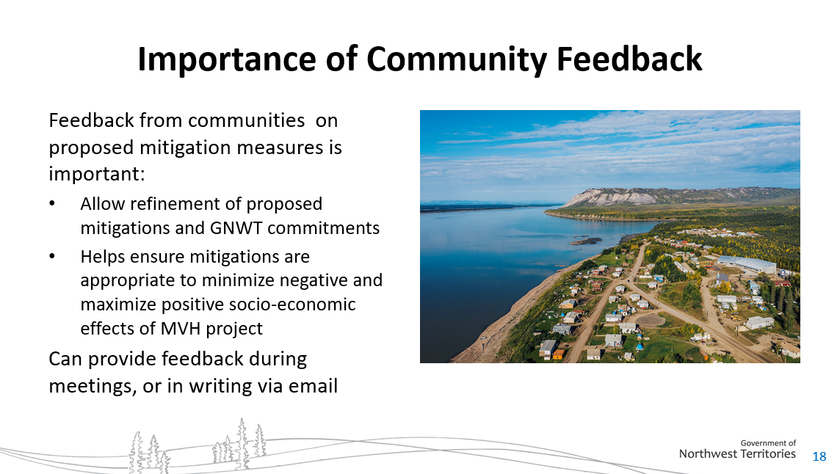
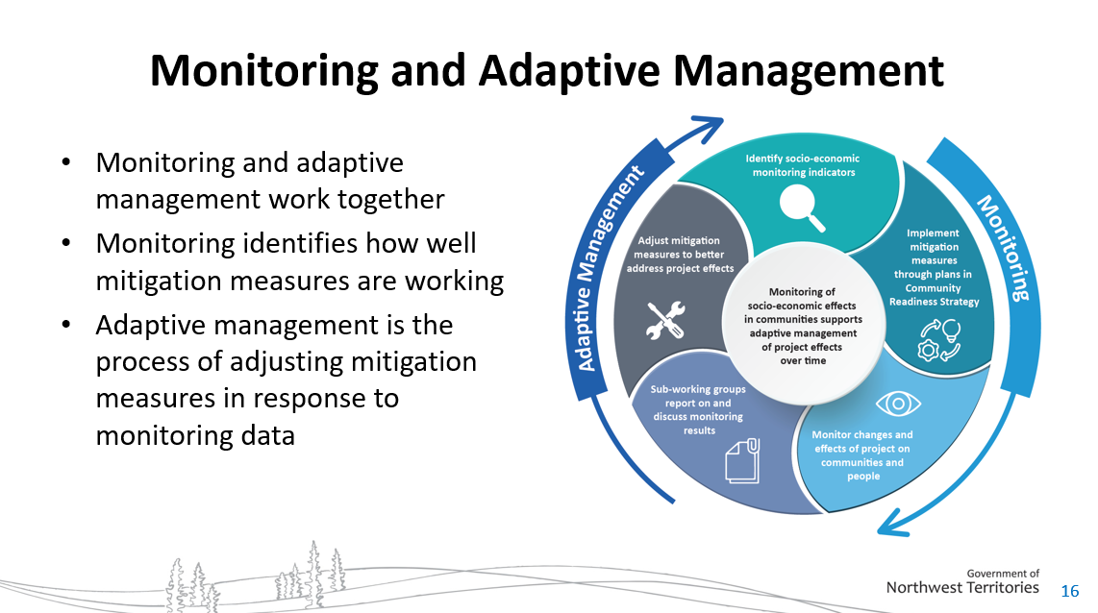
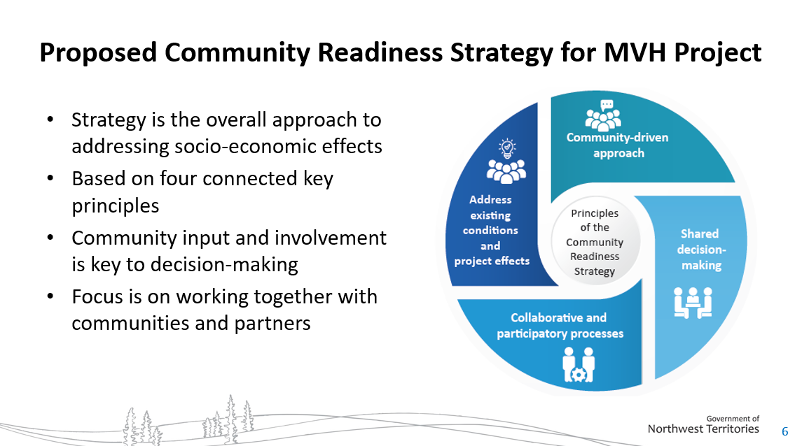
Socio-Economic Mitigation Related Engagement
Engagement on Community Readiness Strategy began May 2024 and is ongoing
Objectives include:
  Introducing proposed Community Readiness Strategy, including MVH Corridor Working Group, Sub-Working Groups and Plans
  Gathering feedback and comments on potential changes
  Identifying any additional measures to address potential socio-economic effects
Engagement to date indicates:
  Community Readiness Strategy addresses right issues
  General support for MVH Corridor Working Group and Sub-Working Groups
  More time needed to prepare and develop (sooner than ‘1 year prior to construction’)
  Community voices (youth, elders) need to be reflected
  Need to work with communities to determine representatives and focus
Notes:
Engagement on Community Readiness Strategy began May 2024 and is ongoing. To date GNWT has engaged with the communities of Norman Wells, Tulita, Fort Simpson/Łı́ı́dlı̨ı̨ Kų́ę́ First Nation on these mitigations
Objectives of the engagement on socio-economic mitigations are to introduce the GNWT commitments and the proposed scope and structure of the working groups and plans that are envisioned to be part of the Community Readiness Strategy.
The GNWT has carried out engagement on the proposed mitigations and remains open to working with communities as the project advances to refine them, if needed. The proposed mitigations may complement the GNWT’s existing programs and services to prepare communities to participate in economic benefits associated with the project. As required, adaptive management responses will be developed collaboratively with communities.
Engagement to date indicates that in general, there is support for the idea of using collaborative working groups that are made up of community representatives, service delivery partners and GNWT departments. The feeling was that the strategy was focused on the right socio-economic issues.
Communities have indicated that they feel more time is needed to prepare and develop the strategy, and it needs to be implemented sooner.
Participants also indicated need for GNWT to continue working with communities to determine representation and focus of the working groups and measures and ensure that community voices are represented.
As outlined in the DAR, the GNWT is proposing to advance development of the Corridor Working Group one year prior to the start of construction. The purpose of this action is to ensure that communities are able to benefit from the training, employment, and business opportunities associated with the project, as well as adapt or prepare for other project impacts. The GNWT has heard a desire from communities to commence this work as soon as possible. The GNWT would like to clarify our commitment, in that we commit to establishing these working groups and related sub-committees a minimum of one year prior to construction. Specific commencement dates will be established through further discussions with communities.

Slide 15
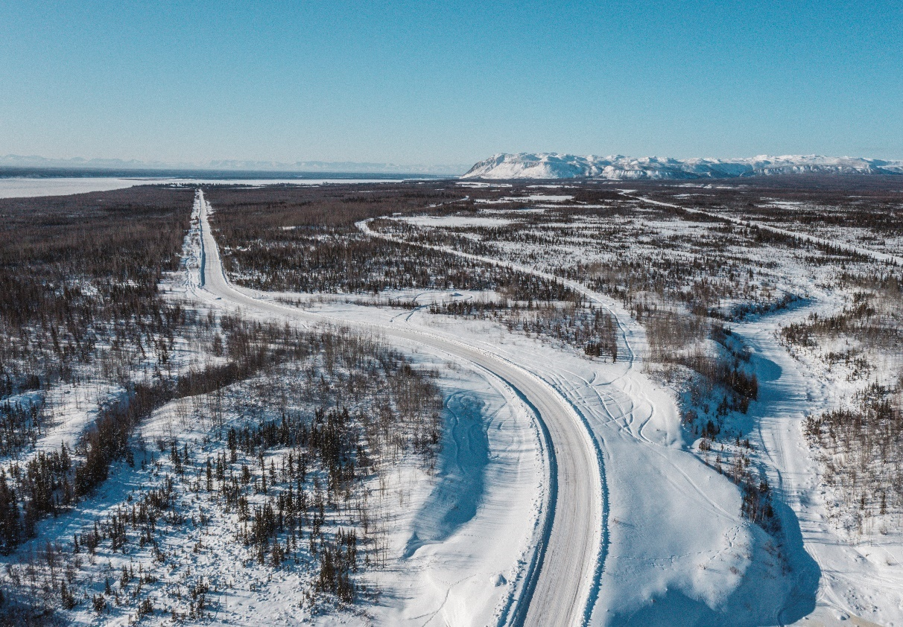
Questions?
Email:
MVH@gov.nt.ca
Project Website: www.inf.gov.nt.ca/en/MVH
Mackenzie Valley Highway EA: https://reviewboard.ca/registry/ea1213-02
Notes:
The GNWT as a whole is committed to working with Indigenous Governments, Indigenous Organizations and communities to prepare for this important project.
Departmental staff continue to be available to discuss participants’ comments as the Review Board’s environmental assessment continues.

