Slide 1
Mackenzie Valley Highway Project
Mackenzie Valley Environmental Impact Review Board Technical Sessions
November 2024

Slide 2
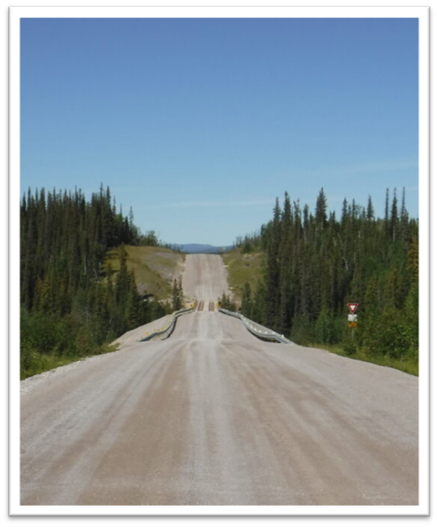
Introductions
GNWT Lead
  Seth Bohnet, Director of Strategic Infrastructure, Infrastructure
GNWT Departmental Representatives
  ECC, ECE, EIA, FIN, JUS, HSS, ITI, MACA, NWT Housing
Discipline Experts (K’alo-Stantec, DPRA)

Slide 3
Project Overview
Mackenzie Valley Environmental Impact Review Board
Technical Sessions​
November 2024

Slide 4
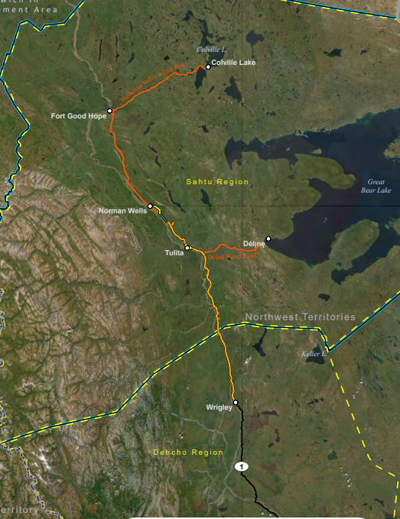
Project Description
The Project will:
Extend the Highway #1 all-season gravel road from Wrigley, to Tulita and Norman Wells
Replace the seasonal Mackenzie Valley Winter Road (MVWR) along this portion
Provide needed infrastructure to support an improved quality of life and lower cost of living for NWT residents in the Mackenzie Valley, as well as support the expansion and diversification of the economy.
4

Slide 5
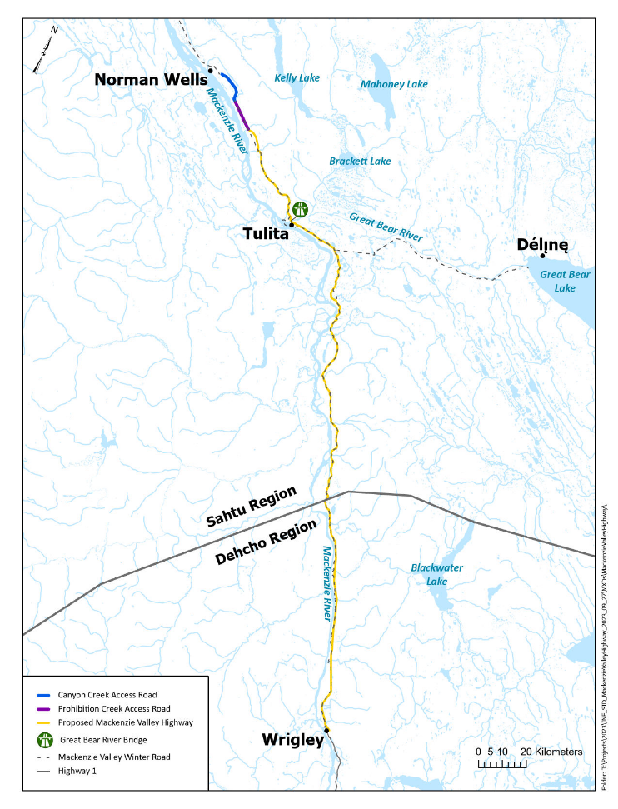
Project Scope
281 kilometres (km) of new highway
  Connect to 23 existing bridges along the MVWR and existing road portions
  Construction of ~85 culverts
  Development of ~6 temporary and 9 permanent quarry and borrow sources and access
  Temporary and permanent support infrastructure and workspaces to support construction
  Construction and operation of permanent maintenance yards
  Closure and reclamation of temporary borrow sources, quarries, and workspaces
  Demobilization of equipment and materials
  Highway operations and maintenance
  Not in MVH Project Scope
  Great Bear River Bridge
  Operations and maintenance of the MVWR
  Use of existing municipal, commercial, or public infrastructure or services, such as municipal solid waste and wastewater facilities
5

Slide 6
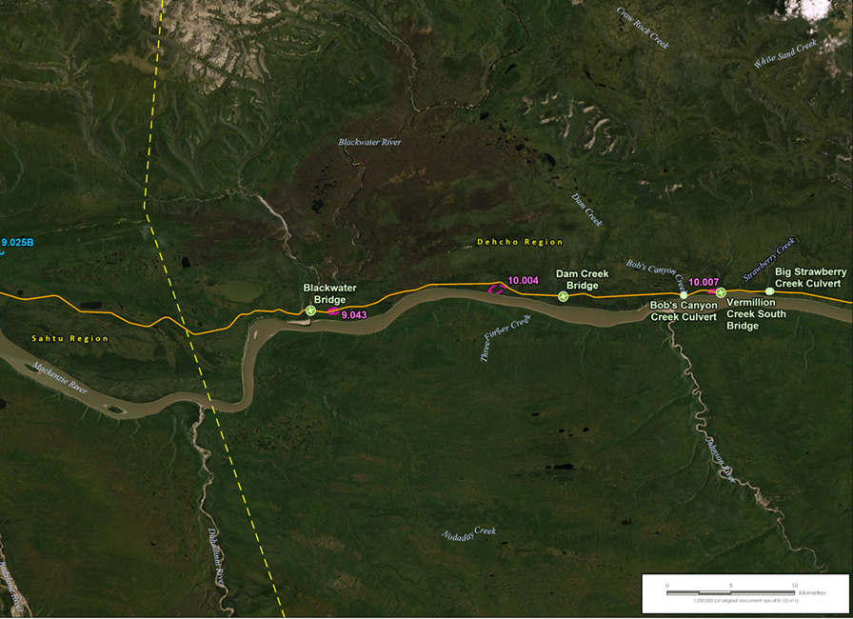
Project Alignment
Proposed alignment mostly follows the MVWR
Designed to standards of rural arterial road (RAU-90)
Builds on region-specific Project Description Reports (2010, 2011)
  Pehdzéh Kį̨ Ndeh – Dehcho Region (PR#13)
  Tulita District (PR#16)
Assessed route is within a 1 km wide alignment routing corridor
Route is not final

Slide 7
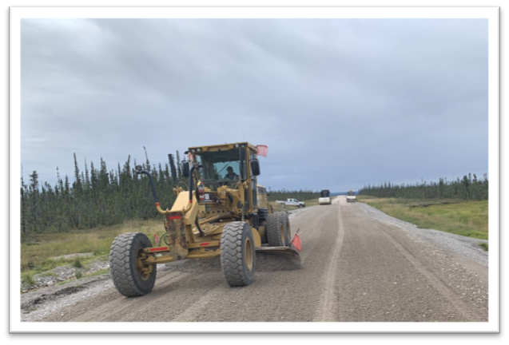
Project Schedule
    3 construction segments
    10 years to build over a 20 year period
    Segments will open to public use once each is built
    MVWR will remain open while construction is underway
    Highway to be operated & maintained by GNWT-Infrastructure

Slide 8
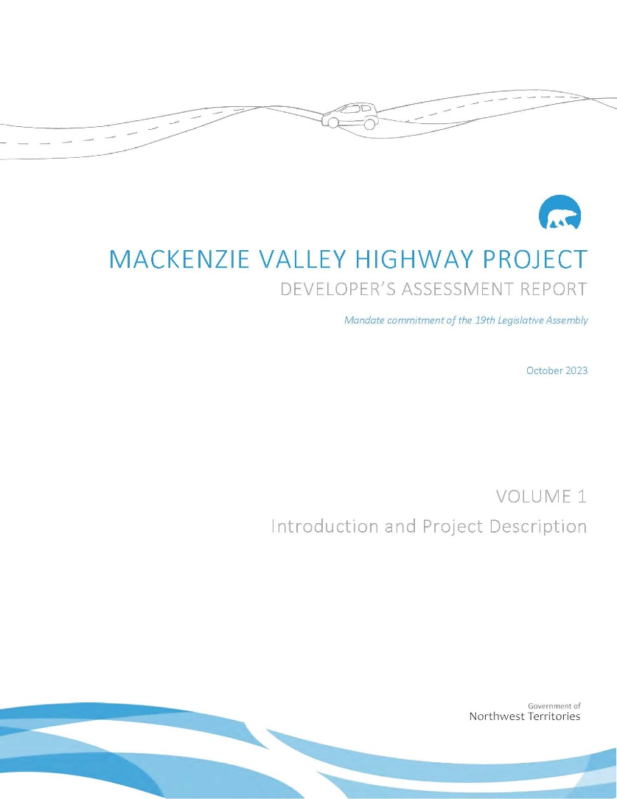
Developer’ Assessment Report
  Developer’s Assessment Report was developed to meet the Review Board’s Revised Terms of Reference issued in 2015
  Submitted to the Review Board in October 2023.
  Review Board determined it met conformity requirements in November 2023

Slide 9
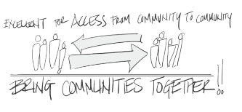
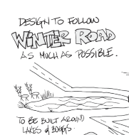
Engagement and Traditional Knowledge
      2010-2012 - Project Description Reports
      2018-2020 - Project Updates
      2021-2024 – Developer’s Assessment Report
        Project description and construction activities
        Potential project interactions and effects
        Mitigation and monitoring
      Traditional Knowledge Studies:
        Tulita Renewable Resources Council
        Norman Wells Renewable Resources Council
9

Slide 10
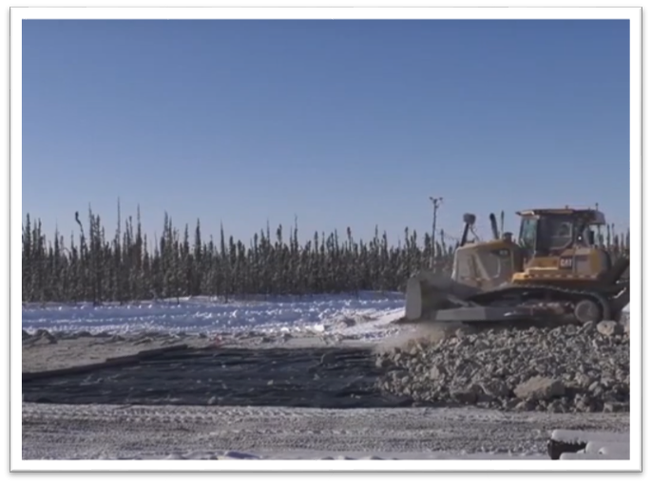
Post-DAR Project Updates
Supplemental Filings Overview
Engagement Updates
Alignment Work
    Reconnaissance Flights – Tulita
    Engineering Studies – PKFN
    Winter 2025 Geotechnical Program
Traditional Knowledge Studies
10

Slide 11
Next Steps
2024
2025
2026
2027 – 20XX
Environmental Assessment Review Board Analytical Phase
Engineering & Design studies
TK studies
Engagement and Indigenous Consultation
Mitigation Engagement and Planning
Review Board Public Hearings and Follow up
Report of Environmental Assessment
Federal Lobbying for Construction Funding
Engagement and Indigenous Consultation
Mitigation Engagement and Planning
Engineering & Design studies
Responsible Ministers’ Final Decision
Establishment of Corridor Working Group
Application for Construction Regulatory Authorizations
Securing Access/Land Tenure
Engagement and Indigenous Consultation
Federal Lobbying for Construction Funding
Procurement (Pending Funding)
Engineering & Design studies
Start Construction (Pending Regulatory Authorizations & Funding)
Engagement and Indigenous Consultation
Construction & Construction Monitoring

Slide 12
Project Overview
Discussion and Questions
12

Slide 13
Impacts on Caribou and Moose
Mackenzie Valley Environmental Impact Review Board
Technical Sessions​

Slide 14
Caribou and Moose (ch.10)
Habitat
  Caribou All-season Resource Selection Function (RSF), Moose Identified Habitat
Movement
  Collared caribou response to existing Mackenzie Valley Winter Road
  (EDI 2024).
  Experience from other highways and caribou and moose.
Mortality Risk
  Direct: collision risk. Indirect: harvest by improved harvester access
Pre-existing significant effect on caribou habitat from fire disturbance in the LAA and
Southern Planning Region
Not significant effect on caribou movement
Not significant effect on mortality risk
14

Slide 15
Caribou and Moose Information Requests
Local Assessment Area spatial scale
Zone of Influence (ZOI) that
quantifies indirect habitat
Updated information on
human disturbance and wildlife layers
Evidence and the potential
barrier effects from the highway
Caribou critical habitat and
habitat biophysical characteristics
​Offsetting caribou habitat loss​
​Cumulative effects spatial scale​
​Potential increased harvest access​
15

Slide 16
Caribou and Moose Responses
Updated habitat disturbance values (DAR Table 10.18) with current human disturbance and wildfire data (Response to MVEIRB-52)
Contextualized predicted effects on caribou and moose based on Project setting
(local ecology, existing disturbance, landscape features)
Incorporated information from supplemental studies, analyses, and the published literature to address outstanding concerns
16

Slide 17
DRAFT Wildlife Management and Monitoring Plan (WMMP) — Caribou and Moose
The draft Wildlife Management and Monitoring Plan (DAR Vol. 5) includes the GNWT’s proposed mitigations, monitoring, and adaptive management for caribou and moose.
Design elements (e.g., 3:1 slope) to allow wildlife crossing (4.4)
Caribou, moose and big game have the crossing right-of-way (4.5)
Wildlife crossings identified and marked (4.5)
Continued collar-based studies for caribou to assess response to road (5.2.2, 5.2.3)
Continued moose surveys (5.2.4)
Access and harvest monitoring (5.2.8)
17

Slide 18
Impacts to Caribou, Moose, and Wildlife
Discussion and Questions
18

Slide 19
Impacts on Other Wildlife
Mackenzie Valley Environmental Impact Review Board
Technical Sessions​

Slide 20
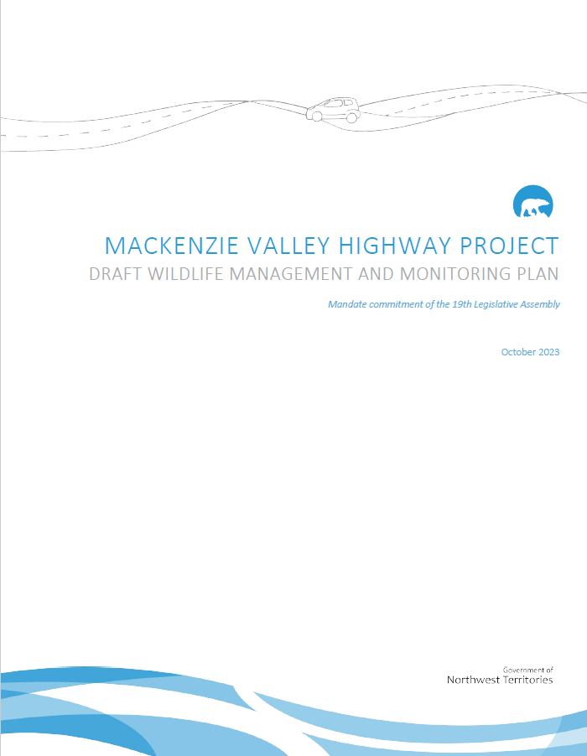
Other Wildlife and Birds (ch.19, 20)
The residual effects of the Project on other Wildlife and Wildlife Habitat, and Birds and Bird Habitat are predicted to be not significant.
Assessment focused on wildlife and bird species at risk, and potential effects on Important Wildlife Areas and Important Bird Areas.
The draft Wildlife Management and Monitoring Plan (Vol. 5 of the DAR) includes the GNWT’s proposed mitigations, monitoring and adaptive management applicable to wildlife and birds.
The GNWT will continue to engage on the Wildlife Management and Monitoring Plan.
20

Slide 21
DRAFT Wildlife Management and Monitoring Plan (WMMP) — Wildlife
Mitigations are primarily focused on reducing areas of new clearing and disturbance, conducting clearing activities in the winter, and controlling dust and noise.
Additional wildlife surveys will be completed before construction, in accordance with the WMMP.
Specific to birds, the GNWT used a habitat-based approach to assessing effects on birds using habitat associations supplemented by Boreal Avian Modelling (BAM) and autonomous recording unit (ARU) data.
The GNWT is open to considering how additional available data can be used to help design the project-specific monitoring programs included in the WMMP.
21

Slide 22
Impacts on Other Wildlife
Discussion and Questions
22

Slide 23
Impacts on Communities
Mackenzie Valley Environmental Impact Review Board
Technical Sessions​

Slide 24
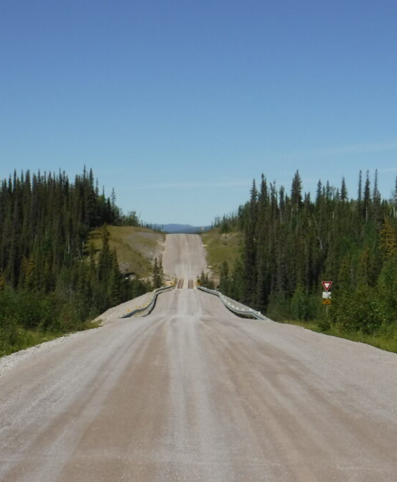
Notable Socio-Economic Assessment Findings
Communities are supportive of the Project and want to be prepared
Most adverse socio-economic effects are not significant when proposed mitigations are applied
Positive effects in areas of education, training, employment and economy
Two significant adverse effects:
  Increased drug and alcohol availability and use (social pressures)
  Construction and operation of road will affect public safety, especially for vulnerable populations
Community Readiness Strategy is proposed to mitigate adverse effects and enhance positive effects

Slide 25
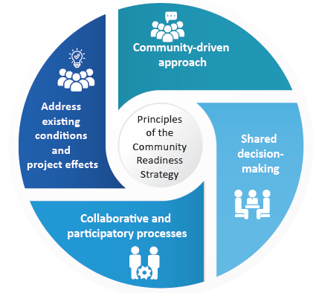
Proposed Community Readiness Strategy
Strategy is the overall approach to addressing socio-economic effects
Community input and involvement is key to decision-making
Focus is on working together with communities and partners
Overseen by Mackenzie Valley Highway Corridor Working Group
  Dedicated Sub-Working Groups and Plans focused on specific issues
Informed by monitoring and adaptive management

Slide 26
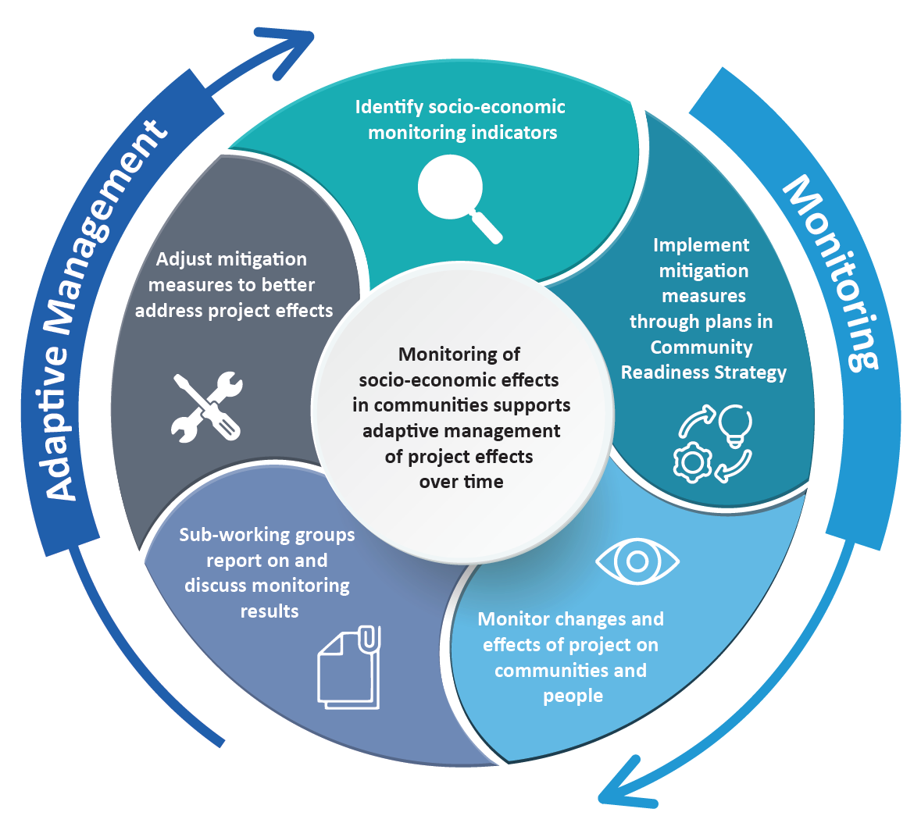
Monitoring and Adaptive Management
Monitoring and adaptive management are critical components of Strategy
Ensures Community readiness Strategy is responsive to community needs and respond to changing socio-economic conditions
Indicators and monitoring will be developed collaboratively with communities

Slide 27
Socio-Economic Engagement
Critical component of assessment, development of mitigations, and future adaptive management and monitoring
  Engagement began in 2020 for the socio-economic assessment
Ongoing engagement on Community Readiness Strategy started May 2024
  Norman Wells, Tulita, Fort Simpson to date
  Objectives include:
    Discussing the proposed Community Readiness Strategy
    Gathering feedback and comments on potential changes to the Community Readiness Strategy
    Including the MVH Corridor Working Group, Sub-Working Groups and associated Plans
Further community engagement meetings planned

Slide 28
Impacts to Communities
Discussion and Questions
28

Slide 29
Impacts on Culture and Traditional Land Use and Harvesting
Mackenzie Valley Environmental Impact Review Board
Technical Sessions​

Slide 30
Culture and Traditional Land Use, Including Harvesting (ch.11)
The Project will not result in long term change to the availability of traditional resources for cultural use, or access to traditional use areas.
The Project will change the availability of harvested resources on, and adjacent to, the PDA that are directly affected by habitat loss (vegetation clearing).
The Project will increase and improve access to traditional use areas, cultural resources, and harvested resources.
Individual land users may experience effects differently.
The GNWT will continue engagement with Indigenous Governments, Organizations, and other affected parties on mitigations.
30

Slide 31
Culture and Traditional Land Use, Including Harvesting (ch.11)
Assessment is based on:
  TLRU studies by the Tulita Renewable Resources Council and Norman Wells Renewable Resources Council
  Project Description Reports (Pehdzeh Ki Ndeh [2012] and Tulita District [2011])
  Publicly available sources
  Project-specific engagement 2010-2012 and 2021-2023
Assessment is conservative – assumes potential cultural use and presence of resources, even if not identified by studies.
The GNWT will review and incorporate additional TLRU information from GNWT-funded studies by Pehdzéh Kį FN and Líídlįį Kúę FN, once available.
31

Slide 32
Impacts on Culture and Traditional Land Use and Harvesting
Discussion and Questions
32

Slide 33
Impacts on Water and Fish
Mackenzie Valley Environmental Impact Review Board
Technical Sessions​

Slide 34
Water Quantity (ch. 15)
The residual effects of the Project on Water Quantity are predicted to be not significant.
The Project’s greatest water needs are during construction (per segment).
Water withdrawal will be in accordance with established protocols and technical guidance, and water licence limits – low magnitude effects.
Potential stream and lake water sources have been identified based on available field data, and desktop evaluation.
This approach is appropriate – source-specific water availability will need to be confirmed in the field prior to licencing/withdrawal.
The presence of groundwater at excavations, quarries, and road cuts will be established during future geotechnical investigations.
34

Slide 35
Water and Sediment Quality (ch.16)
The residual effects of the Project on Water and Sediment Quality are predicted to be not significant.
General effect pathways considered for surface water are:
  Erosion and sedimentation (due to clearing of vegetation, instream works, alteration of permafrost)
  Fugitive dustfall
  Potential ARD/ML (from quarries, rock cuts, stockpiles, embankment materials)
  Potential nitrogen loading from explosives
Mitigations, included management plans, are well-established:
  Erosion and Sedimentation Control Plan − Explosives Management Plan
  Permafrost Protection Plan − Dust control
  Quarry Development Plans
35

Slide 36
Water and Sediment Quality (ch.16)
The Project does not involve point-source discharges to surface water; predictive modelling is not appropriate/practical for the scope of the Project.
  Established mitigations that cover each effect pathway are effective
  A detailed/quantitative characterization of baseline conditions would have no influence on the conclusions of the EA (not necessary or appropriate)
  The baseline section of the EA included a review of available data and a data inventory to support future monitoring objectives
Water quality will be monitored at culvert installation sites (upstream reference and downstream of culvert) during construction.
Performance monitoring will occur, as well as inspection of erosion and sedimentation control measures.
Additional monitoring of relevant water quality parameters could be performed in waterbodies of cultural importance.
36

Slide 37
Fish and Fish Habitat (ch.17)
Potential effects on Fish and Fish Habitat can occur through culvert installations, vegetation clearing, and water withdrawal.
Potential effects on fish health can occur through water withdrawal, changes in water quality, use of explosives near water, and increased access to fishing.
The Project will connect to existing bridge crossings over large rivers/streams.
New culverts will be designed to maintain flow and fish passage.
Fish and fish habitat assessments are ongoing.
Additional geotechnical and hydrotechnical studies will inform crossing designs.
The GNWT will submit site-specific culvert designs and supporting technical studies to DFO to meet requirements of the Fisheries Act. It is too early to identify/confirm offsetting requirements.
37

Slide 38
Fish and Fish Habitat (ch.17)
The draft Erosion and Sedimentation Control Plan is based on industry best practices for erosion and sedimentation control, monitoring, and DFO codes of practice.
Mitigations for effects from changes to Fish and Fish Habitat, and from changes to water quality, are considered effective.
Regular inspections will confirm whether culverts and erosion and sedimentation control measures are working as intended, or whether remedial actions are recommended.
Increased access may lead to overfishing of large-bodied fish. Conservatively, this residual effect is considered significant. The GNWT recommends monitoring of fishing based on TASR experience, and discussion with the resource managers.
38

Slide 39
Impacts on Water and Fish
Discussion and Questions
39

Slide 40
Impacts on Terrain and Permafrost
Mackenzie Valley Environmental Impact Review Board
Technical Sessions​

Slide 41
Terrain, Soils and Permafrost (ch.14)
The residual effects of the Project on terrain, soils, and permafrost will be mostly limited to the PDA. They will be not significant.
Changes to terrain and permafrost are anticipated primarily from clearing, ground disturbance, and changes to local drainage patterns.
Mitigations to reduce effects are included in the Permafrost Protection Plan and Erosion and Sedimentation Control Plan (Volume 5 of the DAR).
Principal mitigations include:
  Limiting areas of new disturbance, excavation, cuts
  Advancing work in new areas when the ground is frozen
  Avoiding areas of sensitive soils/terrain where possible
  Installing drainage culverts
41

Slide 42
Terrain, Soils and Permafrost (ch.14)
Permafrost is warm and discontinuous. It will continue to warm and disappear over the life of the Project.
Project-specific design mitigations are intended to protect the infrastructure where effects on sensitive soils cannot be avoided.
Site-specific geotechnical information (e.g., soils, ice content, temperature) will be used for site-specific design.
Proposed ongoing monitoring and inspection is described in the PPP.
42

Slide 43
Impacts on Terrain, Soils, and Permafrost
Discussion and Questions
43

Slide 44
Impacts on Air Quality, Noise, and Vegetation
Mackenzie Valley Environmental Impact Review Board
Technical Sessions​

Slide 45
Air Quality, Greenhouse Gas (ch.12)
The residual effects of the Project on Air Quality from changes to criteria air contaminants (CACs) are predicted to be not significant.
The assessment considers the effects from CAC emissions to human health and the environment from emission sources that are mobile, transient and temporary.
The greenhouse gas assessment estimates Project emissions compared to NWT total emissions.
Mitigations include best practices to reduce emissions during construction:
    A dust control program to reduce dust emissions
    Efficient operation of construction equipment
    Reduce areas of new clearing, and promote natural revegetation
The GNWT also plans to develop an Adaptive Air Quality Management Plan involving the monitoring of CAC concentrations at key receptors.
45

Slide 46
Noise (ch.13)
The residual effects of the Project on noise are predicted to be not significant.
The noise assessment considers noise emissions received by receptors in communities, which may lead to adverse effects such as annoyance.
Noise mitigations include best practices to reduce noise during construction:
    Reduce use of residential roads for construction equipment
    Blast techniques and procedures
    Efficient operation, and maintenance of construction equipment
    Inform communities of upcoming noise-emitting construction events including time period and type of activity
The GNWT also plans to develop a noise complaint resolution plan to track noise complaints, and responses to manage and mitigate feedback.
46

Slide 47
Vegetation and Wetlands (ch.18)
The residual effects of the Project on Vegetation and Wetlands are predicted to be not significant.
The assessment predicts permanent changes to vegetation within the PDA from direct clearing, and indirect effects within and adjacent to the PDA (e.g., dust, edge effects, invasive species, wetland clearing).
Principal mitigation is to reduce areas of new disturbance by following the Mackenzie Valley Winter Road as much as possible.
Invasive species will be managed through regular mowing.
Periodic invasive plant surveys will identify areas of infestation that may require additional mitigation.
Targeted surveys of species of conservation concern, and specific plant species of interest, will be conducted prior to construction.
47

Slide 48
Impacts on Air Quality, Noise and Vegetation
Discussion and Questions
48

