Slide 1
Project Initiation and Planning
Choosing the Best Contracting Strategy (for your project)
Michelle McMillan, P.Eng.
mmcmillan@revay.com
November 26, 2019

Slide 2
AGENDA
Introduction and Background
Common Issues in Construction
Project Delivery Methods
Key Contract Clauses

Slide 3
Introduction and Background
B.Sc. Civil Engineer
Project Work
Claims
Today’s Presentation

Slide 4



Introduction and Background
I’ve been working with Revay and Associates Limited in the Calgary office since 2001
I like “Procastibaking” and hiking (slow walks in nature)

Slide 5

Introduction and Background
I am NOT a lawyer

Slide 6


Common Issues in Construction
What we are building?
When does it need to be finished?

Slide 7

Common Issues in Construction
How much will it cost?

Slide 8
Project Delivery Methods
Which one is best?

Slide 9
Contracting Strategies
Design – Bid – Build (similar to EPCM)
Design – Build (similar to EPC)
Public Private Partnerships (PPP or P3)
Integrated Project Delivery (IPD)

Slide 10

Design-Bid-Build
Description
The “traditional” project delivery method
Perceived to be a safe, conventional method that has stood the test of time
Most likely to end up in my office
Considered by some to be the most adversarial method

Slide 11
Design-Bid-Build
1
2
3
Facility designed by Designer (Consultant) for Owner
Project tendered
Contract awarded to Contractor who builds the facility

Slide 12
Design-Bid-Build
Owner
Designer
Contractor
Parties involved
Owner:
  Initiates project
  Acquires land, obtains financing, defines
  project requirements
Designer (Consultant):
  Responds to Owner’s Request for Proposal (RFP)
  Selected on a qualifications based system (may or may not include a consideration for price)
  Paid an agreed-upon fee
Contractor:
  Selected on the basis of the lowest responsive bid
  Fixed price contract (either lump sum or unit prices, or a combination thereof)

Slide 13
Design-Bid-Build
 | Responsibilities |  | Risk
Owner | Define project requirements Control over design development Review and approve proposed design |  | Liable for quality and deficiencies of design vis-à-vis Contractor No separate entity for overall coordination Poor performance of Contractor or many change requests due to contract award to lowest bidder
Designer | Develop design Prepare tender documents May represent Owner during construction phase (review and inspect construction) |  | Liable for completing design in timely fashion
Contractor | Build according to Designer’s plans and specifications Allocate sufficient qualified resources Coordination with subcontractors |  | Liable for work of subcontractors Mistakes during construction Compliance with design

Slide 14
Design-Bid-Build
Schedule
Typically longer duration
Linear sequence (no overlap)
Cost
Lower initial construction cost (competitive bidding)
Low level of confidence of initial cost estimate (design phase)
Quality
End-product typically meets Owner’s initial requirements
Contractor aware of quality required at time of bid
Schedule typically more reliable (but quality of design documents often negates advantage)
Construction cost known at bid
Difficult and costly to implement changes once construction begins

Slide 15
Design-Bid-Build
Possible causes of conflict
Conflicts between Owner and Contractor:
  Unexpected soil conditions
  Difficulty in accessing the site
  Late delivery of components
  Lack of coordination between architectural and engineering drawings
  Changes to the project
Risks of conflicts minimized by:
  Tender documents that clearly state what is expected from each party
  Fair allocation of the risks between the parties
  Realistic contractual duration and budget

Slide 16
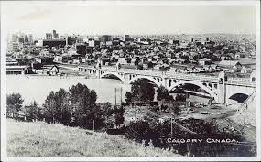
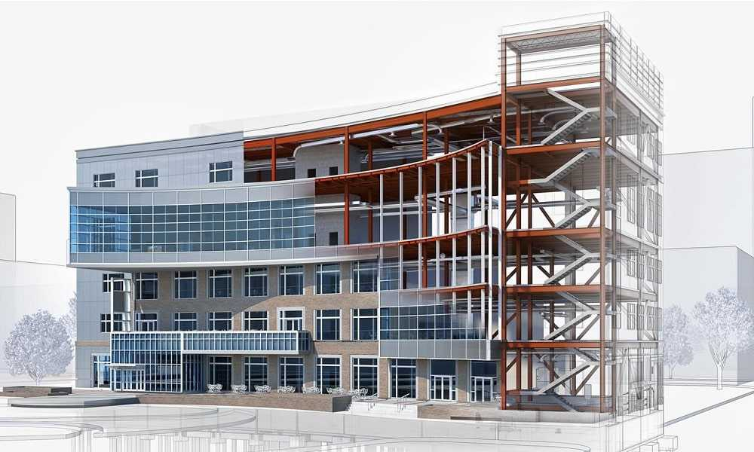
Design-Bid-Build – Examples
Owner
Designer
Contractor

Slide 17

Design-Build
Description
Single entity is responsible for both design and construction

Slide 18
Design-Build
1
2
3
Owner prepares Request for Qualifications (RFQ)
Owner retains
3 to 5 Design-Builders who submit RFPs
Contract awarded to Design-Builder who designs and builds the facility

Slide 19
Design-Build
Owner
Design-Builder
Designer
Contractor
Parties involved
Owner:
  Prepares Request for Qualifications (RFQ)
  Prepares Request for Proposal (RFP)
    Statement of Requirements (SOR)
    Supplemental information
Design-Builder (Designer and Contractor):
  Can be single firm (has all the necessary in-house staff or subcontracts part of the work), a consortium, or a joint venture
  Selected on the basis of value (qualifications of Design-Builder, fulfillment of requirements and quality of proposed design solution, and reasonableness of price)
  Contract: fixed price, cost reimbursement plus fixed fee, or guaranteed maximum price (GMP)

Slide 20
Design-Build
 | Responsibilities |  | Risk
Owner | Clearly state all requirements in SOR Provide accurate, reliable, and complete design parameters and other performance requirements |  | Inadequate or incomplete requirements Liable for faulty specifications Little to no control over the design process Liable for changes to design during review process or for interfering or becoming too actively involved Lack of Owner representation on the Design-Build team
Design-Builder | Develop design in compliance with Owner’s performance specifications Build the facility |  | Liable for errors and omissions in the design Misinterpretation of Owner’s performance specifications Usual risks associated with construction Liable for guaranteeing that the facility can be used safely and adequately for its intended purposes

Slide 21
3. Design-Build
Schedule
Typically shorter duration
Ability to fast-track
Cost
Design-Builder more inclined to save costs
Quality
Quality of the design sacrificed (Design-Builder might cut costs and design time)
Owner relies on Design-Builder for quality assurance
High cost of Owner changes
Cost not necessarily known by Owner before bids received

Slide 22
Design-Build
Possible causes of conflict
Owner should identify problems, not solutions
Owner must understand that it cannot specify both:
  Result or performance expected
  Way to achieve it
Owner must not become actively involved or interfere
Conflict if the method, design, or equipment specified by the Owner does not meet its own performance requirements

Slide 23

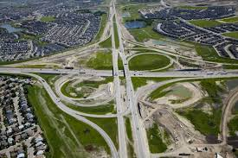
Design-Build – Examples
Owner
Design-Builder
Designer
Contractor

Slide 24
Public Private Partnerships (P3)
Description
Increasingly popular in Canada for the construction of large, complex, government-owned facilities
  Typically used for publicly owned facilities such as hospitals, schools, recreational and cultural complexes, courthouses, detention centers, water treatment plants, bridges, etc.
Canadian Council for Public-Private Partnerships definition:
  A cooperative venture between the public and private sectors, built on the expertise of each partner, that best meets clearly defined public needs through the appropriate allocation of resources, risks and rewards.
Most P3 models include:
  Private sector financing
  Provisions for maintenance and operation of the constructed facility (quarter to a third of a century, if not longer)

Slide 25
Public Private Partnerships (P3)
P3 partnership
Public partner (Owner)
Private partner
Parties involved
Public sector partner:
  Government
  (federal, provincial, or municipal)
Private sector partner:
  Composed of consortium of firms (concessionaire or special purpose vehicle)
  Consortium typically includes managers and financiers, and could include constructor and design teams
  Consortium generally subcontracts parts of the work
    Consulting engineers
    Design teams
    Maintenance and operation specialists
    Contractors

Slide 26
Public Private Partnerships (P3)
Steps
Public sector partner hires compliance team (also known as planning and compliance consultants or the Owner’s engineer) to prepare project requirements and performance specifications
Owner submits RFQ
Owner evaluates responses and selects short list of consortia to which it issues a RFP (including requirements, specifications, and preliminary designs)
Owner selects consortium based on qualifications, proposed technical solution, and cost
Consortium or Joint Venture designs and builds the facility, but can also finance, operate, and sometimes own the facility

Slide 27
Public Private Partnerships (P3)
 | Responsibilities |  | Risk
Public sector partner | Clearly state all project requirements Provide accurate, reliable, and complete performance specifications |  | Differs from one P3 model to another and depends on the specific project agreement
Private sector partner | Design, build, finance, maintain, operate |  | High pursuit cost Increased financial risks due to the added complexity of P3 Potential lack of knowledge, resources and experience if new to P3s Reliance on team commitment Lack of control over the changing financial markets and inflation

Slide 28
Public Private Partnerships (P3)
Schedule
Prolonged procurement phase tends to extend overall project duration
Cost
Generally more costly (higher procurement costs due to added intricacy and heavier structure)
Quality
No independent Owner representation on the consortium
However, this time could be recovered during construction due to the private sector’s increased efficiency and innovation
Public partner benefits from potentially efficient and innovative facility resulting in lower construction and/or maintenance and operations costs
Certainty over cost for the duration of the agreement
Quality could improve if the consortium is responsible for maintenance and operation

Slide 29
Public Private Partnerships (P3)
Possible causes of conflict
Possible causes of conflicts related to the definition of the requirements (whether during the construction phase or the operating/maintenance phase) and the quality of the work (especially when it is turned over to the ultimate Owner)
Changes are major problems because of the financing costs
Financial difficulties on the part of the concessionaire, which may go as far as bankruptcy, may also cause significant problems

Slide 30


Public Private Partnerships (P3) – Examples
P3 partnership
Public partner (Owner)
Private partner

Slide 31
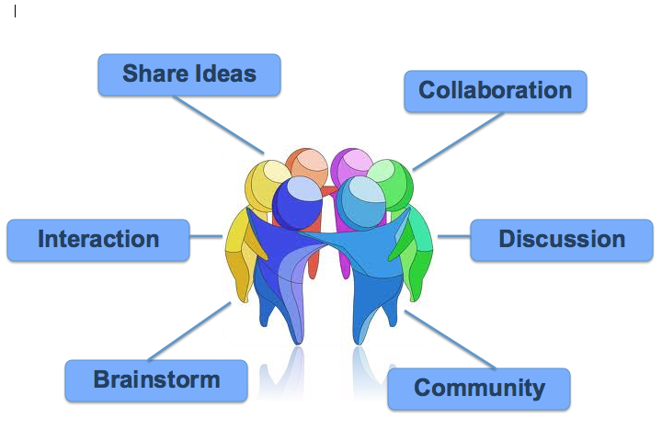
Collaborative Contracting

Slide 32
Integrated Project Delivery (IPD)
Description
Also known as Collaborative Project Delivery
Latest form of project delivery method to emerge in the construction industry
Gaining popularity in the United States, but still extremely new to Canada
Based on the direct collaboration of the parties involved as well as the involvement of all the major team players as early as possible
Unified team: Minimizes adversarial relationships
Overall success of the project supersedes individual goals of the team members
Decisions made collaboratively
More efficient working environment, design, and construction
Most powerful tool used to achieve collaboration: Building Information Modeling (BIM)

Slide 33
Integrated Project Delivery (IPD)
Multi-party agreement
Owner
Designer
Contractor
Sub-consultant
Sub-contractor
Parties involved
Team:
  Owner
  Designer
  Contractor
  Optionally, other critical members such as
  Sub-consultants or Subcontractors
All parties bound by a single multi-party agreement
Team members selected by the Owner on a qualifications based system
  Can be pre-qualified based on technical competence, commitment to integrated practice, experience and track record, proven integrity, commitment to a collaborative process, etc.
  Brought in at the outset of the project

Slide 34
Integrated Project Delivery (IPD)
Responsibilities and Risks
Cannot be separated between parties because assigned on a “best person” basis
Multi-party agreement clearly outlines responsibilities
Owner could be required to give up overall control by embracing the collaborative control
If all parties are transparent and collaborative, the risks could be greatly minimized
Shared risks, shared rewards

Slide 35
Integrated Project Delivery (IPD)
Schedule
Overall schedule is reduced
Cost
More accurate budget (input from all parties)
Quality
Improved due to collaboration
Lengthier pre-construction/design phase, but shorter construction phase (minimized re-design time, BIM model)
More accurate schedule (input from all parties)
Shared financial risks and rewards (not compulsory)
E.g.: target cost with distribution of cost savings and cost overruns
E.g.: profit pool (Owner’s contingency and team members’ profit margins)

Slide 36
Integrated Project Delivery
Possible causes of conflict
Project delivery method in which less conflicts arise
If a single party becomes non-collaborative, the entire project is jeopardized
Conflicts could arise during the procurement stage as all potential team members must agree on:
  Terms and conditions of the multi-party agreement
  Project targets and constraints

Slide 37

Integrated Project Delivery (IPD)
Multi-party agreement
Owner
Designer
Contractor
Sub-consultant
Sub-contractor

Slide 38
Project Delivery Methods
CM as Constructor
Design-Build
Owner
CM as Constructor
Designer
Subcontractors
CM as Agent
Design-Bid-Build
Owner
Design-Builder
Owner
CM as Agent
Designer
Contractor
Owner
Designer
Contractor
Multi-Prime
Owner
Designer
Contractor 1
Contractor 2
Contractor n
Optional CM
IPD
Multi-party agreement
Owner
Designer
Contractor
Sub-consultant
Sub-contractor
EPCM
P3
Owner
Subcontractors
EPCM Contractor
P3
partnership
Public partner (Owner)
Private
partner

Slide 39
Conclusions
No universally good or bad project delivery method
Owner must clearly identify its needs and requirements to determine which one best suits the project
Owner’s choice is largely dependent upon its knowledge and expertise in the field of construction and the nature and importance of the risks it is ready to undertake
Contractor must understand the responsibilities, risks, and rewards associated with the project’s delivery method
Ultimately, a proper appreciation of the different project delivery methods will lead to more efficient project deliveries through less adversarial relationships and fewer unwelcomed surprises

Slide 40
Questions & Discussion
Thank you!

