Slide 1
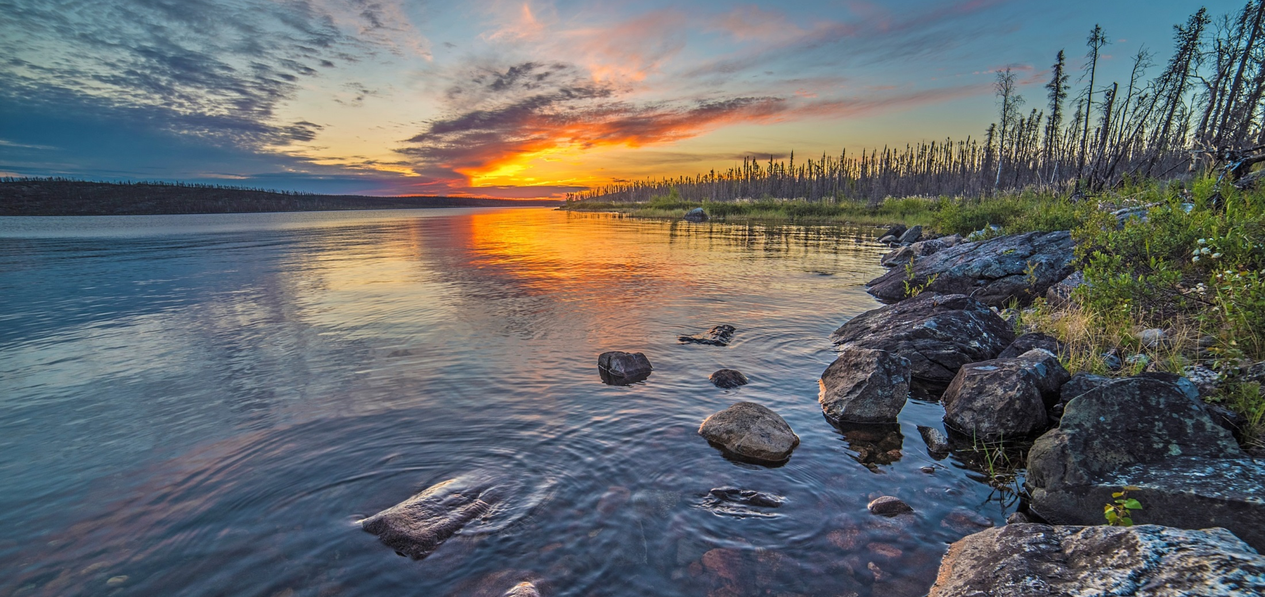
CONNECTING TO OPPORTUNITIES
NWT Transportation Corridors
Project Management Conference ― November 2019

Slide 2
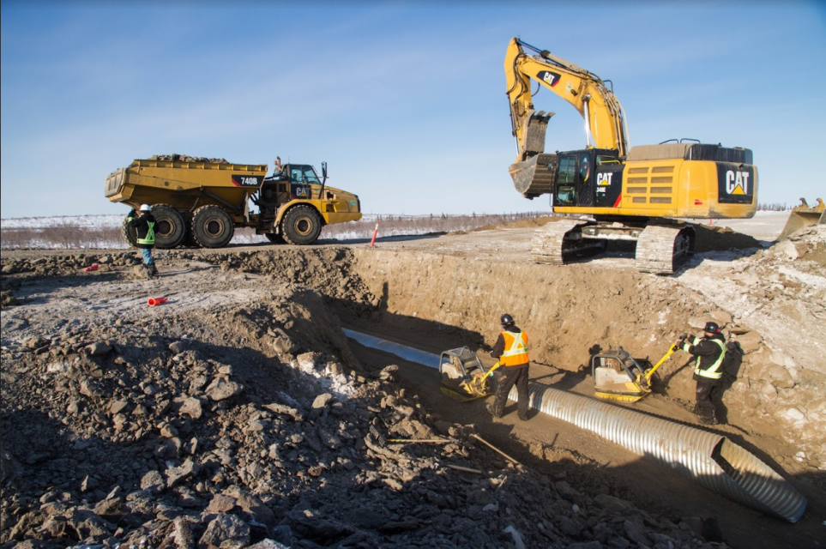
CONNECTING TO OPPORTUNITIES
Why Invest in Infrastructure?
Important for growth of NWT economy
Provide access to mineral and petroleum resources
Support development of strong northern workforce and business opportunities
Increase resiliency to impacts of climate change
Reduce the cost of living
Improve social opportunities
Promote tourism opportunities

Slide 3
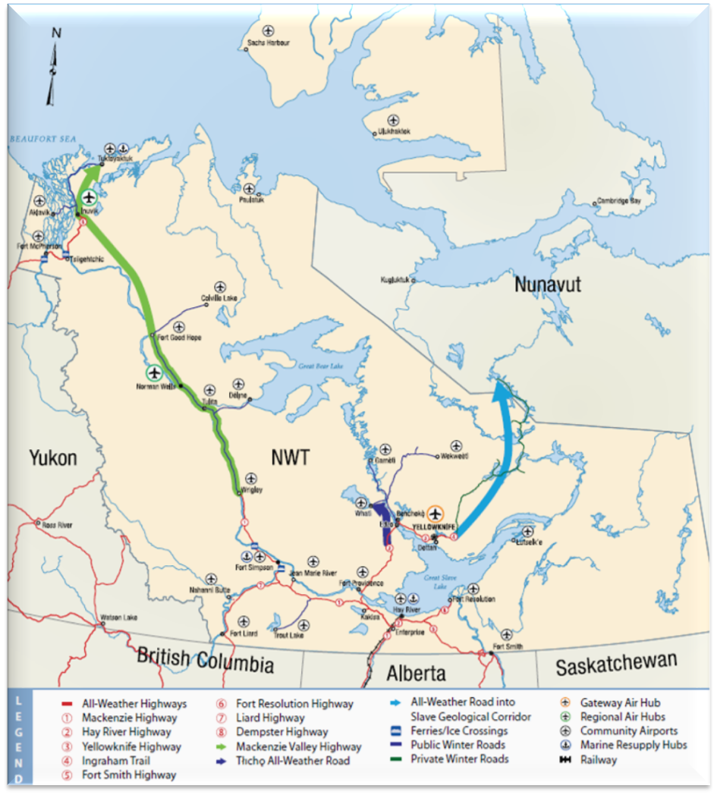
CONNECTING TO OPPORTUNITIES
Strategic Transportation Corridors
GNWT is pursuing three strategic transportation corridors:
Tłįchǫ All-Season Road
Mackenzie Valley Highway
Slave Geological Province Corridor
Identified as priorities in GNWT’s 25 Year Transportation Strategy Connecting Us
Strategic infrastructure investments included in priorities of the 19th Legislative Assembly
Make strategic infrastructure investments that connect communities, expand the economy or reduce the cost of living, including the Mackenzie Valley Highway, the Slave Geological Corridor and the Taltson Hydro Project.

Slide 4
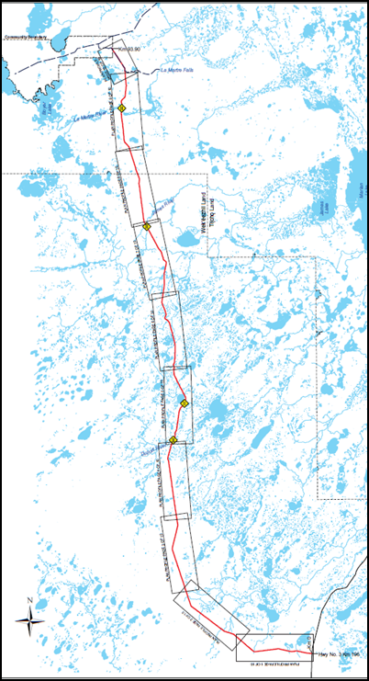
CONNECTING TO OPPORTUNITIES
Tłı̨chǫ All-Season Road
97 km highway from south of Behchokǫ̀ to Whatì
Infrastructure Canada providing 25% of capital costs
P3 Project Agreement with North Star Infrastructure to design, build, finance, operate and maintain the road
Tłįchǫ Investment Corporation is equity partner in North Star Infrastructure to construct and operate road
Project Agreement specifies Indigenous and northern involvement for training, employment and business opportunities
Construction started September 2019
Opening expected 2022

Slide 5
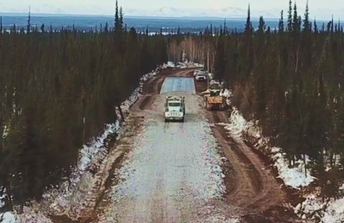
CONNECTING TO OPPORTUNITIES
Mackenzie Valley Highway
Governments have invested over $145 million in MVH since 2000 (not including the ITH)
Inuvik Tuktoyaktuk Highway open November 2017
15,000 travelers in first year
Increased tourism
Permafrost research
Canyon Creek Access Road opened November 2018
14 kilometre access road south from Norman Wells along MVH alignment
Increased capacity for residents to take advantage of future construction of Mackenzie Valley Highway
Current focus on segment from Wrigley to Norman Wells

Slide 6
CONNECTING TO OPPORTUNITIES
MVH ― Currently Funded Projects
$140 million announced June 2018
Great Bear River Bridge
Mount Gaudet Access Road
MVH Environmental Assessment and Engineering (Wrigley to Norman Wells)
Other funded projects
Oscar Creek Bridge
Hodgson Creek Bridge (to be included in Mount Gaudet Access Road project)
Opportunity for additional funding for future highway construction under Investing in Canada Plan

Slide 7
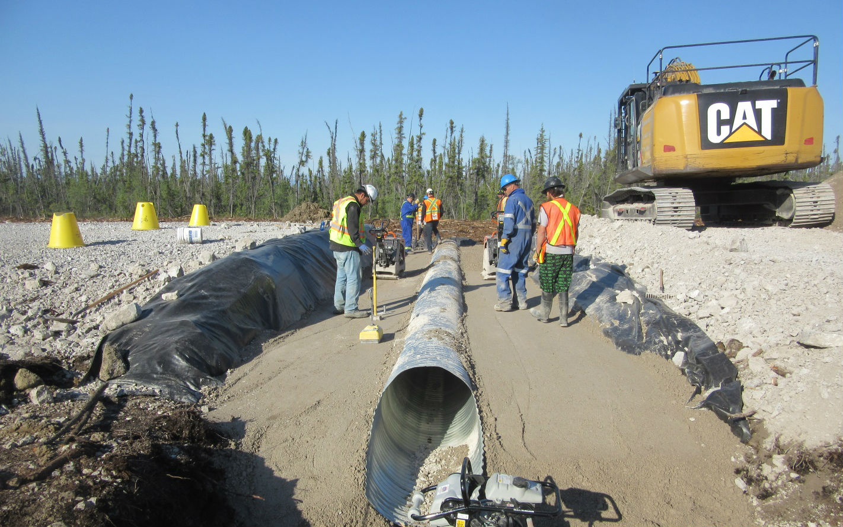
CONNECTING TO OPPORTUNITIES
MVH Construction
Construction of major sections of the MVH between Wrigley and Norman Wells will occur when:
EA has been completed
All regulatory authorizations have been obtained
Land access/tenure has been secured in accordance with Sahtu Dene and Metis Land Claim Agreement
Funding for construction has been secured
Possible exceptions – short road extensions from communities along MVH alignment

Slide 8
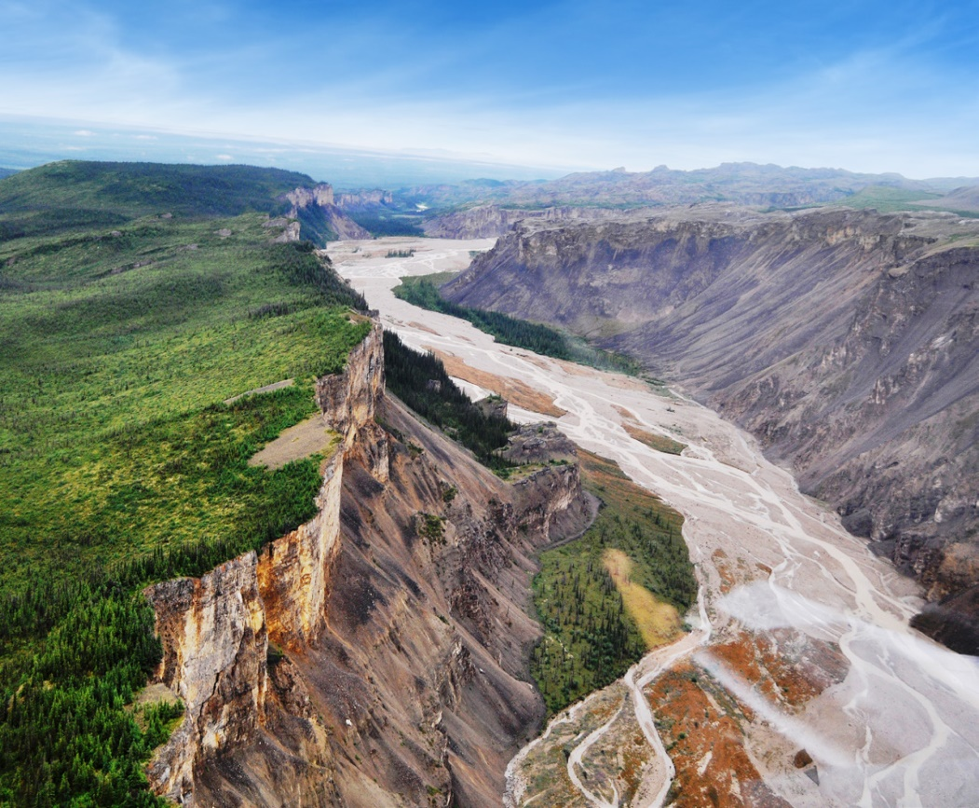
CONNECTING TO OPPORTUNITIES
MVH Environmental Assessment
Developer’s Assessment Report (DAR)
Completion of the DAR is the next major step in the EA
Target date for completing DAR is September 2021
Technical studies required to complete the DAR
Traditional knowledge
Socio economic
Environmental
Archaeological
Land use
Engineering

Slide 9
CONNECTING TO OPPORTUNITIES
MVH EA ― Anticipated Timeline

Slide 10
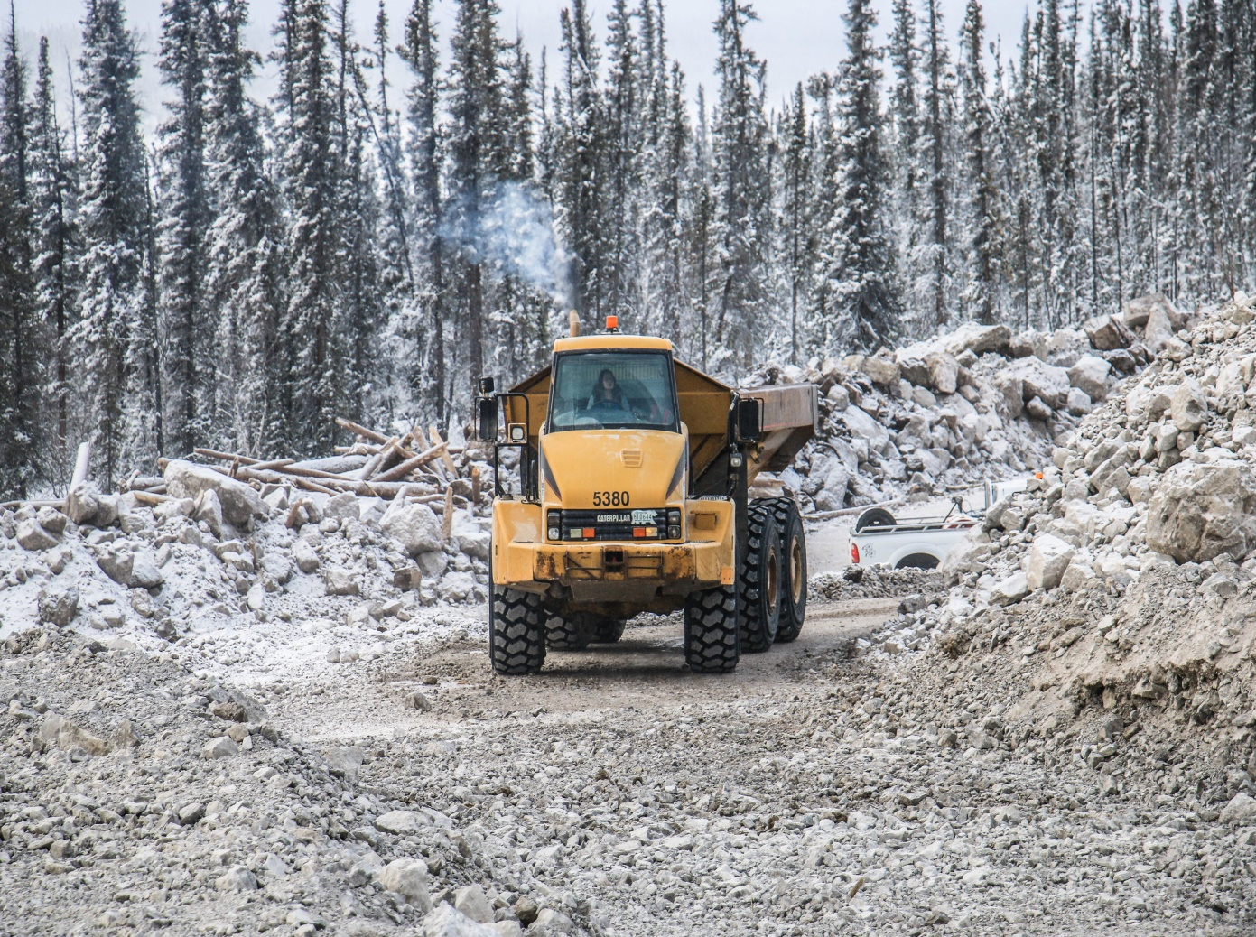
CONNECTING TO OPPORTUNITIES
Road Extension Projects
Short road extensions from communities along MVH alignment (Canyon Creek)
Capacity building projects to ensure residents can take full advantage of future construction of the MVH
81 people were employed at peak construction of Canyon Creek Access Road
Could advance separately from the MVH EA
Will require community support and approval of regulatory boards

Slide 11
CONNECTING TO OPPORTUNITIES
Proposed Road Extension Projects
Mount Gaudet Access Road
Construction of approximately 15 kilometres of all-season road
Includes replacement of Hodgson Creek Bridge
Prohibition Creek All-Season Road
Construction of approximately 14 kilometres of all-season road
Four Mile Creek Road
Upgrade winter access road to all-season road
Considering in relation to Great Bear River Bridge project

Slide 12
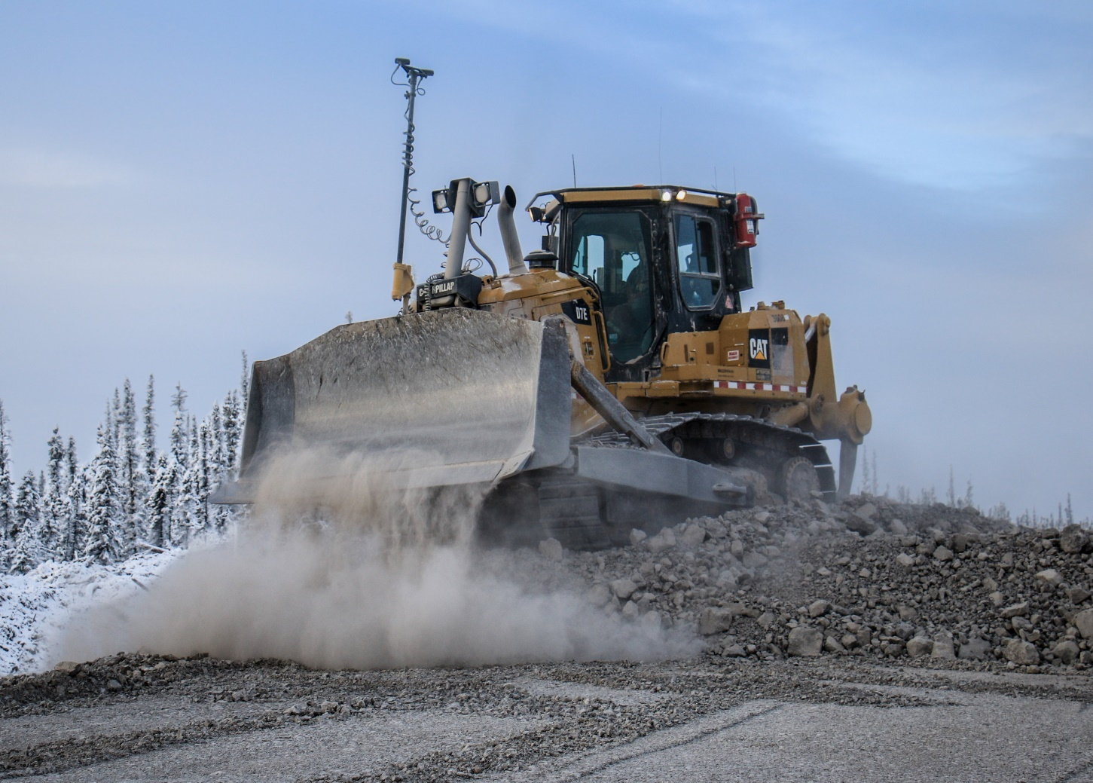
CONNECTING TO OPPORTUNITIES
Mount Gaudet Access Road (MGAR)
Proposed 15 km all-season road from Wrigley to Mount Gaudet
Funded under National Trade Corridors Fund
Will be built along alignment of existing Mackenzie Valley Winter Road with adjustment for new Hodgson Creek Bridge
Anticipate between 12 and 18 months to complete construction

Slide 13
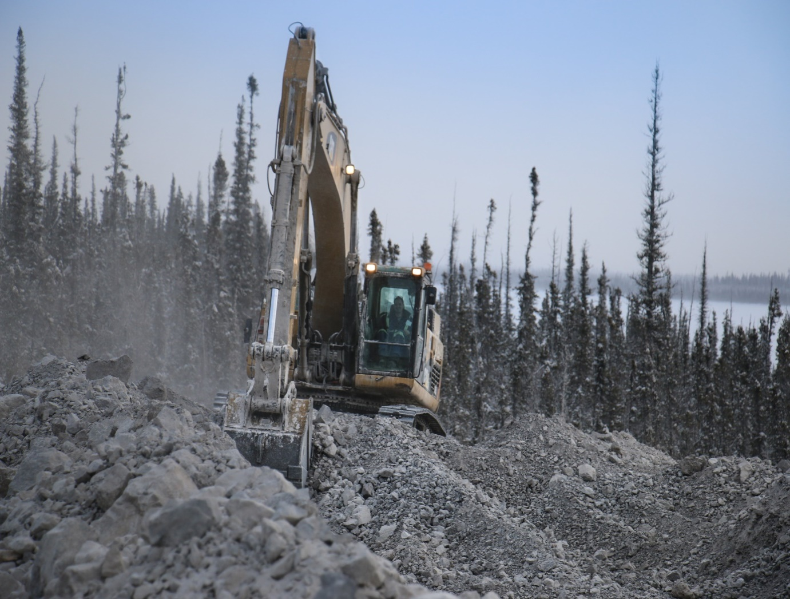
CONNECTING TO OPPORTUNITIES
Prohibition Creek Access Road (PCAR)
Proposed 14 km all-season road from Canyon Creek to Prohibition Creek
Construction funding to be secured
Will be built along alignment of existing Mackenzie Valley Winter Road
Anticipate between 12 and 18 months to complete construction

Slide 14
CONNECTING TO OPPORTUNITIES
PCAR and MGAR― Anticipated Timeline

Slide 15
CONNECTING TO OPPORTUNITIES
Four Mile Creek Road
Considering in relation to Great Bear River Bridge project
Training/capacity building opportunities
Develop winter access road from Mackenzie Valley Winter Road to GBRB as part of GBRB project
Design for winter access road being completed as part of GBRB design
Upgrade winter access road to all-season road after completion of GBRB project
Construction funding for all-season road to be secured

Slide 16
CONNECTING TO OPPORTUNITIES
Slave Geological Province Corridor
New 413 km infrastructure corridor into Slave Geological Province north from Yellowknife
Corridor would include road, energy and communications
Long-term vision to connect Canada’s highway system to a deep-water port on the Arctic Ocean in Nunavut
Future connection to Grays Bay Road and Port project being pursued by Kitikmeot Inuit Association
Additional consultation and engagement, engineering and environmental studies required to assist in final route alignment – need to balance maximizing access to mineral potential with minimizing negative impact on environment/wildlife/traditional use areas
Bathurst Caribou
Beverly Caribou
Bluenose East and
Ahiak Caribou
Notes:
Goal is to create all-weather access into SGP
World-class deposits - significant contributor to the NWT economy
Climate change and increased traffic for mine resupply threatening winter road system.
Shortened operating seasons – increased costs
Reduce costs for industry activities – mining industry needs boost
Significant possibilities for a strengthened sustainable development partnership with governments of Nunavut and Canada and Aboriginal partners
Continuing to meet with Nunavut to advance progress in both jurisdictions
Nunavut submitted proposal to Canada for Grays Bay project – Complements NWT vision

Slide 17
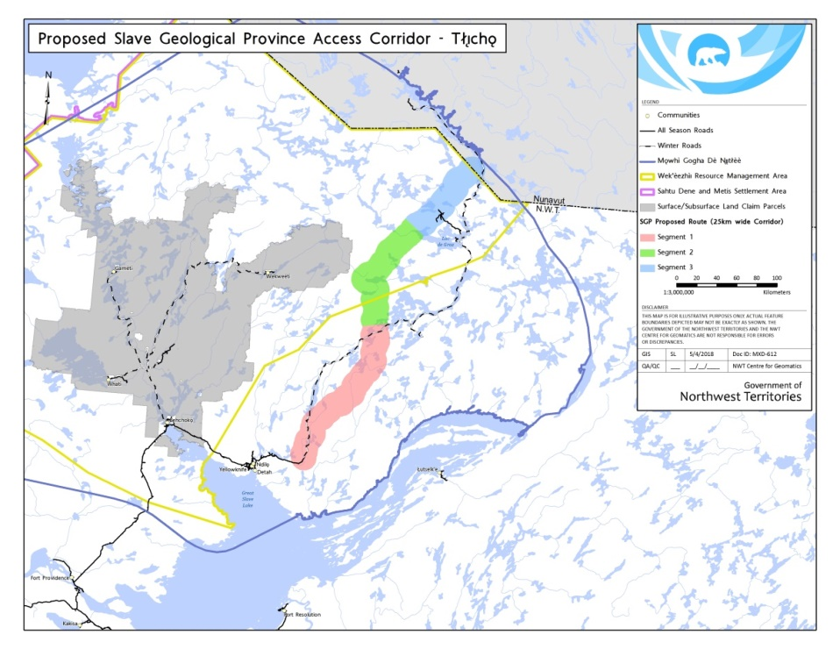
CONNECTING TO OPPORTUNITIES
Slave Geological Province Corridor
GNWT is early in process for developing project but significant opportunities to advance it
Indigenous partnerships being developed
$40 million funding announced in August 2019 under National Trade Corridors Fund to support planning and environmental and regulatory reviews leading to permits for road construction
Three potential construction phases:
1. Tibbitt Lake to Lockhart Lake (179 km)
2. Lockhart to Lac de Gras (152 km)
3. Lac de Gras to NWT/Nunavut border (82 km)

Slide 18
CONNECTING TO OPPORTUNITIES
SGP Corridor — Next Steps
Environmental impact assessment and regulatory authorizations for the construction of the proposed Lockhart All-Season Road (LASR)
Prepare and submit Project Description Report for LASR to initiate environmental impact assessment process (March 2021)
Partnerships with Indigenous governments
Community consultation and engagement
Confirm routing for alignment
Technical studies to investigate engineering, land use, archaeological and environmental issues
Planning studies for future development from Lockhart Lake to Nunavut border

Slide 19
CONNECTING TO OPPORTUNITIES
LASR – Anticipated Timeline
November 2019
Years to Completion

Slide 20
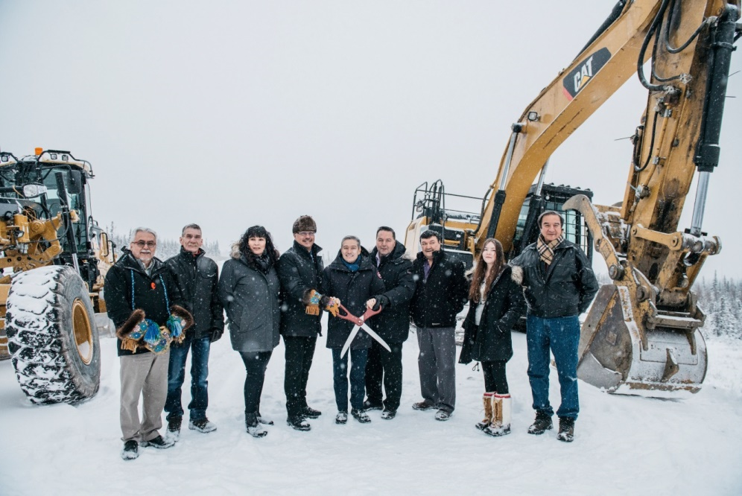
CONNECTING TO OPPORTUNITIES
Participation
Developing formal working relationships through MOUs with Indigenous governments
Section 35 consultation
Public/community engagement
Opportunities for public debate through environmental impact assessment and permitting processes
SGP@gov.nt.ca / MVH@gov.nt.ca

Slide 21
Thank you.
www.inf.gov.nt.ca/projects

